Slide 1
Presentation about Progress in NRSR
Jiayu Chen
2023.8.07
Notes:
Noise reduction and signal reconstruction.

Slide 2
Work
Plan
Questions
Notes:
I will divide my presentation into 3 parts:
Part 1, I will introduce the work I did this week
Part 2 is some plans for next week
In Part 3, there are some questions.

Slide 3
Work: Get Template Heartbeat Signal – Build Pipeline
De-noise
Detect Peaks
Estimate HR, RR
Slice
Cluster and Stack
Get Template Signal
Notes:
This week, I try build a pipeline to get the Template heartbeat signal.
So, the Pipeline has six parts:
1. First, cleaning up the data to remove noise.
2. Finding the peaks in the signal.
3. Estimate the heart rates and respiratory rates.
4. Slice the signal into segments.
5. Group similar parts of segments by using clustering.
6. Finally,. We Get the Template signal
I get inspiration from some research papers the Prof Song recommended last week.
Ok, I’ll explain what I did at each step.

Slide 4
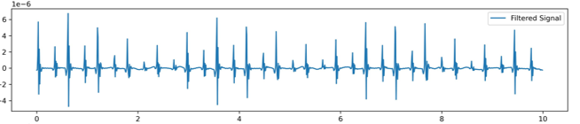
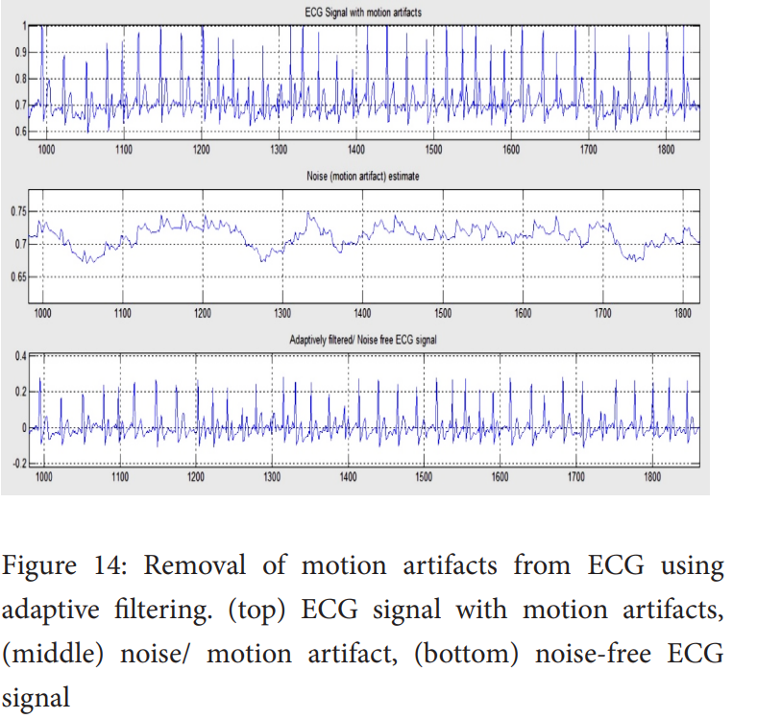
Work: Get Template Heartbeat Signal – Denoise
Paper:
Use adaptive filters to remove noise from Electrode Motion Artifacts(EMA)
Signal with EMA
Noise
Motion Artifacts -> ECG
Respiratory Rate -> SCG
Filtered signal
Notes:
Professor Song, you shared this paper with me.
The last subsection of this paper talks about using adaptive filter to remove noise form Electrode Motion Artifacts.
Take a look at the image on the left. This is the original image from this paper.
It shows a signal affected by EMA, with a pronounced fluctuation.
And, this fluctuation seems quite similar to the breathing-related fluctuation we observe in our SCG signal.
The author applied an adaptive filter to the signal affected by EMA.
And you can see the "Filtered signal" shows almost no trend and their peaks remain stable.
SO, I attempted to apply the adaptive filter to process our SCG signal to remove the impact of respiratory Rates

Slide 5
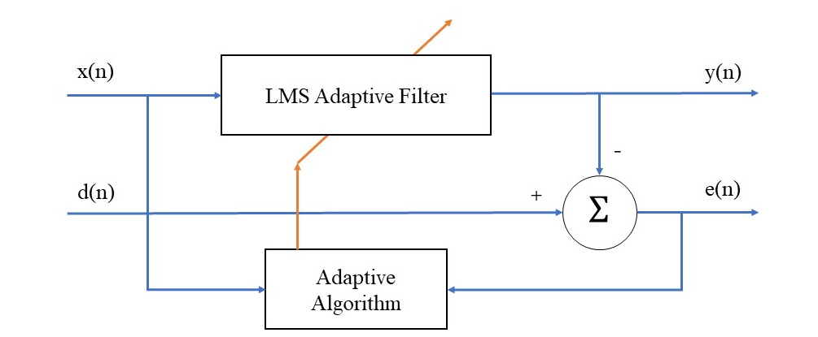
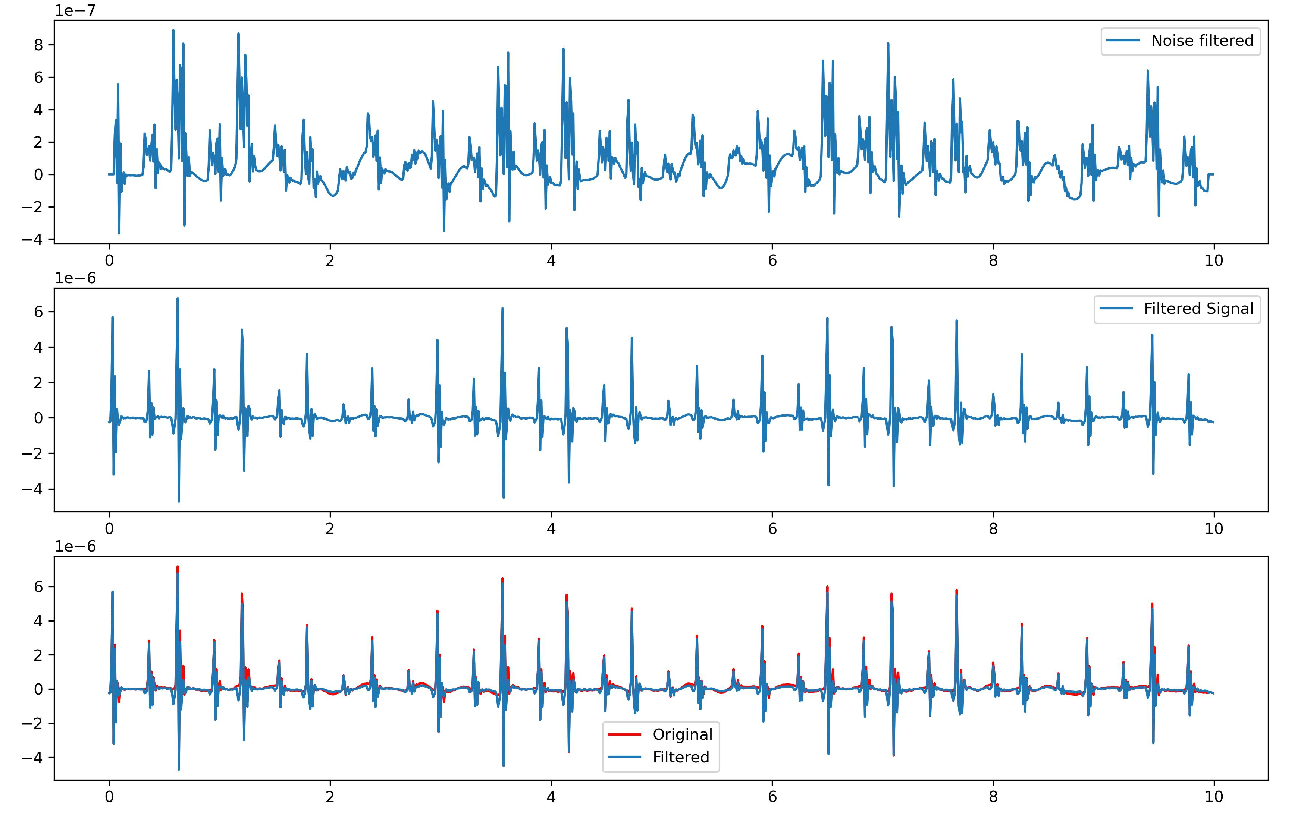
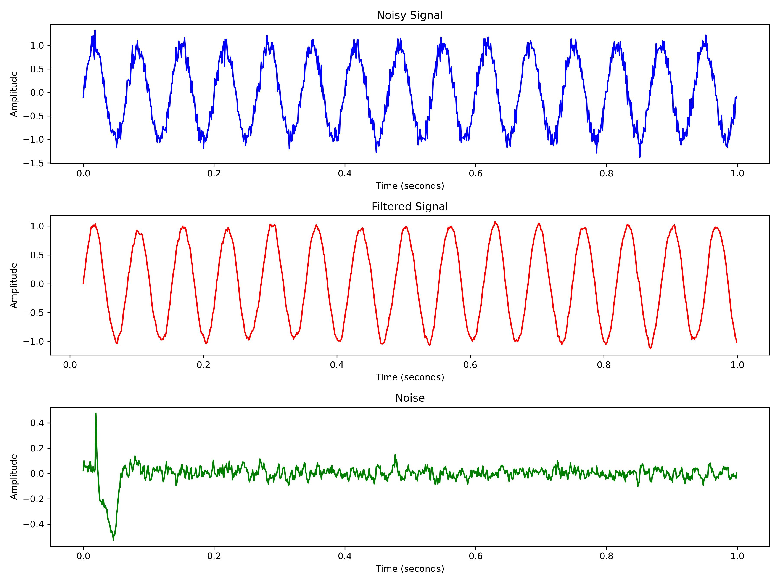
Work: Get Template Heartbeat Signal – Denoise
LMS learns filter's weights based on the error between the input signal x(n) and the desired signal d(n)
In the paper: d(n) <- x(n)
Concept of Least Mean Squares(LMS)
Try to Remove the impact of RR by using LMS
Example of the Least Mean Squares(LMS)
Notes:
So I did some work about adaptive filters.
based on an online MATLAB code, I implement an adaptive filter using the Least Mean Squares (LMS) algorithm.
Additionally, I‘ve created a simple tutorial for reference. I commited it to my github.
The Picture above illustrates the concept of an adaptive filter.
Below, there’s an easy example of an adaptive filter using LMS.
I think An adaptive filter based on LMS is quite similar to backpropagation. It learns the filter's weights based on the error between the input signal and the desired signal.
So, choosing desired signal is essential.
In the paper , the author used input signal as Desired signal
Following the paper's approach, I applied this filter to our SCG signal. The top graph shows the filtered-out noise, and in the bottom picture. The Red line shows the original signal
The blue line shows the filtered signal. The blue line still has pronounced fluctuations.
This filter doesn’t work.
I think The biggest problem is I didn’t choose the right desired signal. I still need more investigation about this approach .

Slide 6
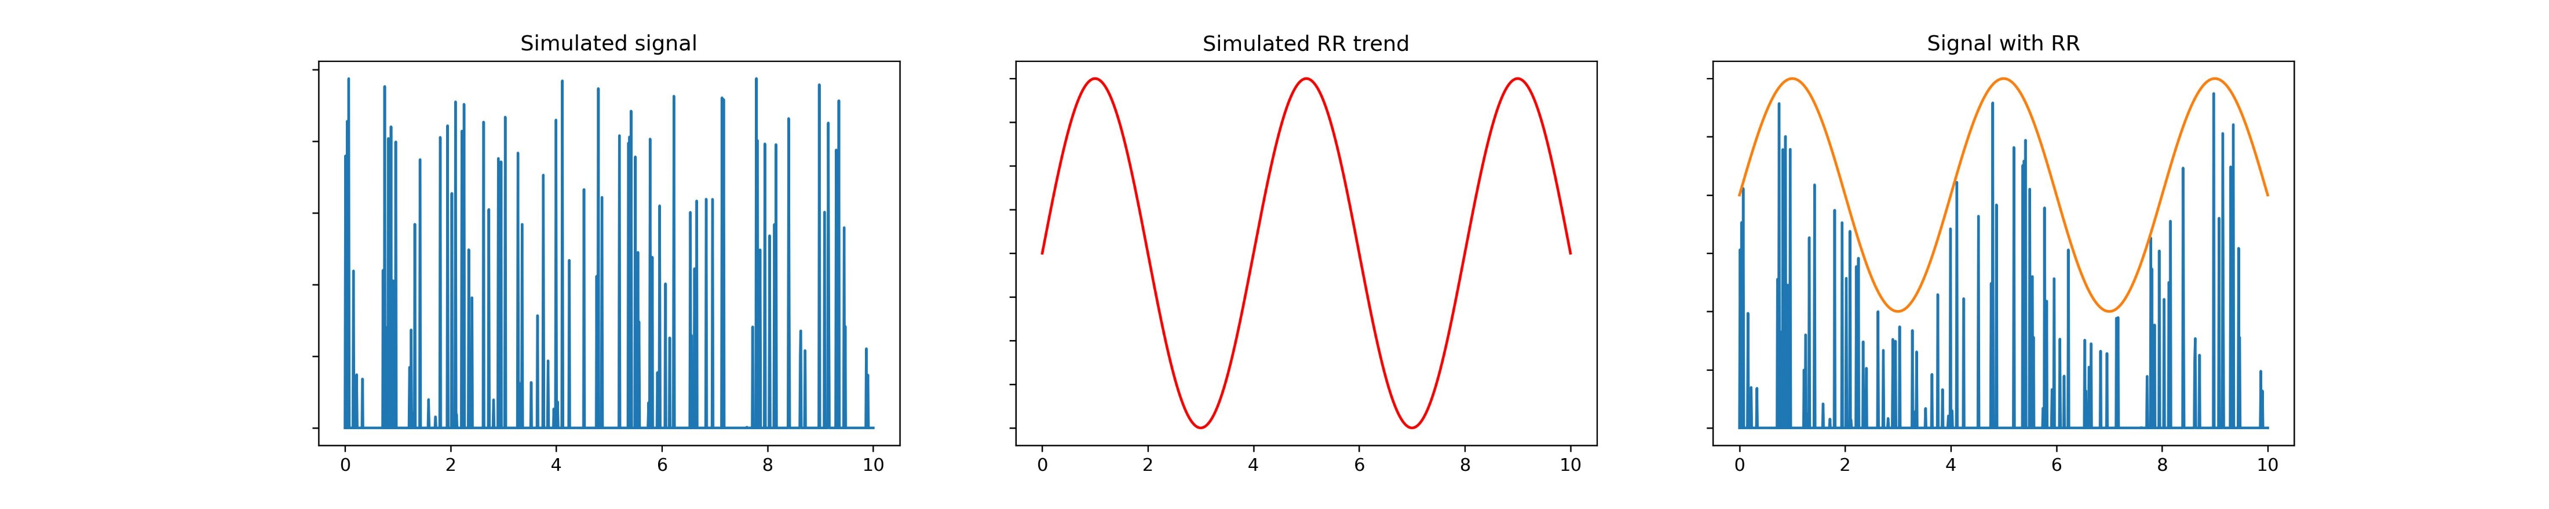
Work: Get Template Heartbeat Signal – Denoise
Look at how RR is simulated in SCG signals.
Neurokit2 -> scg -> scg_simulate.py -> _scg_simulate_Daubechies()
x
A sine/cosine function > 0
The impact of RR is multiplied by, rather than added to, Original signal.
Guess: Maybe get the envelope of RR, and divide the noisy signal by the envelope?
Notes:
I was curious about how the impact of Respiratory Rate is actually applied to the SCG signal.
So I examined the source code for simulating SCG signals in neurokit2.
The specific operation is carried out within this function.
Briefly, they multiply a simulated signal with a positive sine or cosine function.
The impact of RR is multiplied by, rather than added to Original signal.
Guess: Maybe get the envelope of RR, and divide the noisy signal by the envelope?
I Failed to remove the Rrespiration, I will spend more time on it next week.

Slide 7

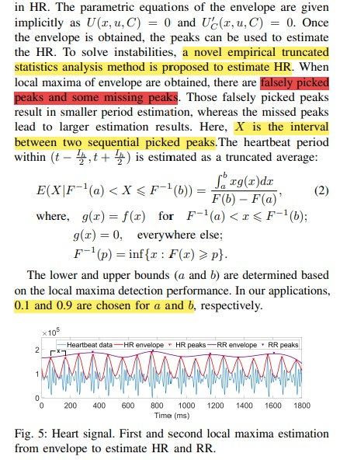
Work: Get Template Heartbeat Signal – Peaks Detection and HR&RR Estimation
HR&RR Estimation in Helena
Step1. Obtain HR Envelope and get HR peaks ->
Step2. Empirical Truncated Statistics Analysis(ETSA) ->
Step3. HR Estimation ->
Step4. Use HR Peaks to generate the respiratory envelope by extrapolating ->
Step5. RR Estimation
My Implementation of HR&RR Estimation
Step1. Peaks Detection(old_algo, new_algo) ->
Step2. Empirical Truncated Statistics Analysis(ETSA) ->
Step3. HR Estimation ->
Step4. Use HR Peaks to do interpolation and get the respiratory envelope ->
Step5. RR Estimation
Notes:
Ok, let’s look at the second part.
This week, I'm trying to implement the algorithm related to HR and RR estimation from your paper "Helena." Yeh, it is your paper, we have discussed it before.
In this process , I've encountered some challenges. Maybe you can give me some guidance after the presentation.
The process for HR and RR estimation in the Helena paper is roughly as follows:
Step 1: Obtain the HR envelope and extract HR peaks.
Step 2: Apply Empirical Truncated Statistics Analysis (ETSA).
Step 3: Perform HR estimation.
Step 4: Utilize HR peaks to generate the respiratory modulation signal through extrapolation.
Step 5: Perform RR estimation.
Here's what I've done in practice:
1. Used two peak detection algorithms to obtain HR peaks.
2. Applied Empirical Truncated Statistics Analysis for HR estimation.
3. Finally, used interpolation to obtain RR estimation.
However, I've encountered some difficulties along the way.

Slide 8
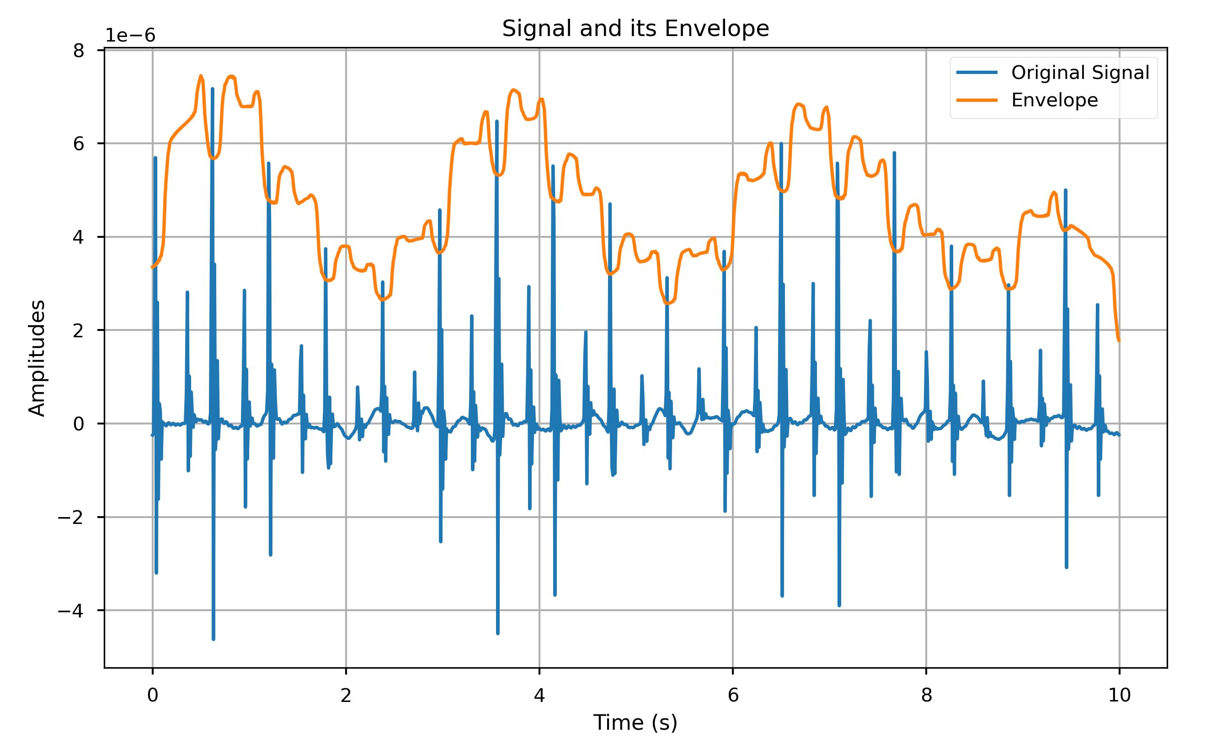
Work: Get Template Heartbeat Signal – Peaks Detection and HR&RR Estimation
Paper gives the parametric equations of the
envelope implicitly, like U(x, u, C) = 0
？？？
Obtain the HR envelope
A Method Online
Hilbert transform
extract the envelope
smooth the envelope
This envelope can’t be used to find HR peaks
Low-quality Envelope
Notes:
The first challenge is how to generate a high-quality HR envelope.
The paper only briefly mentions the HR envelope with these instructions:
"You give the parametric equations of the envelope implicitly. Obtain the envelope. I don't know what happened?"
I've found a method online:
They did like this.
First, I apply the Hilbert transform to the original signal, extract the envelope, and then smooth the envelope.
The yellow curve on the right means the extracted envelope,
and when compared to the red HR envelope extracted in your paper, it's evident that the one I obtained isn't suitable for identifying HR peaks.
So, this the first problem.

Slide 9
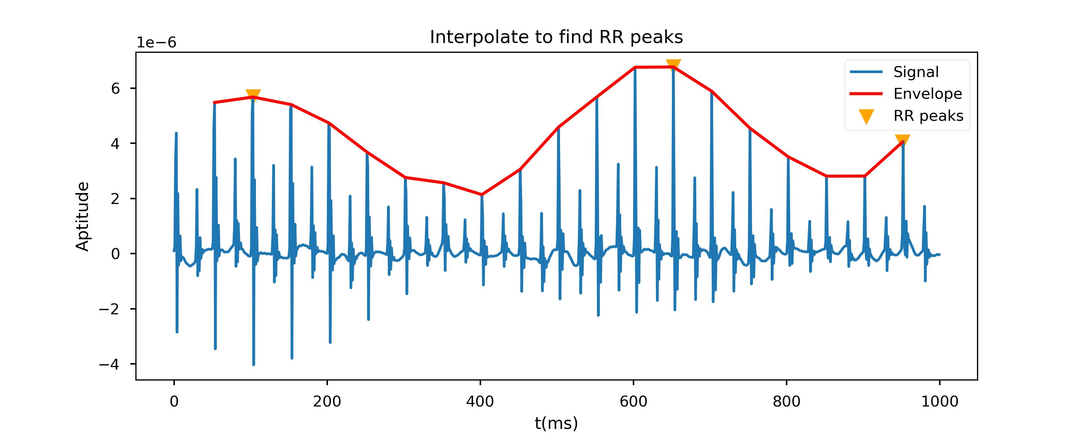
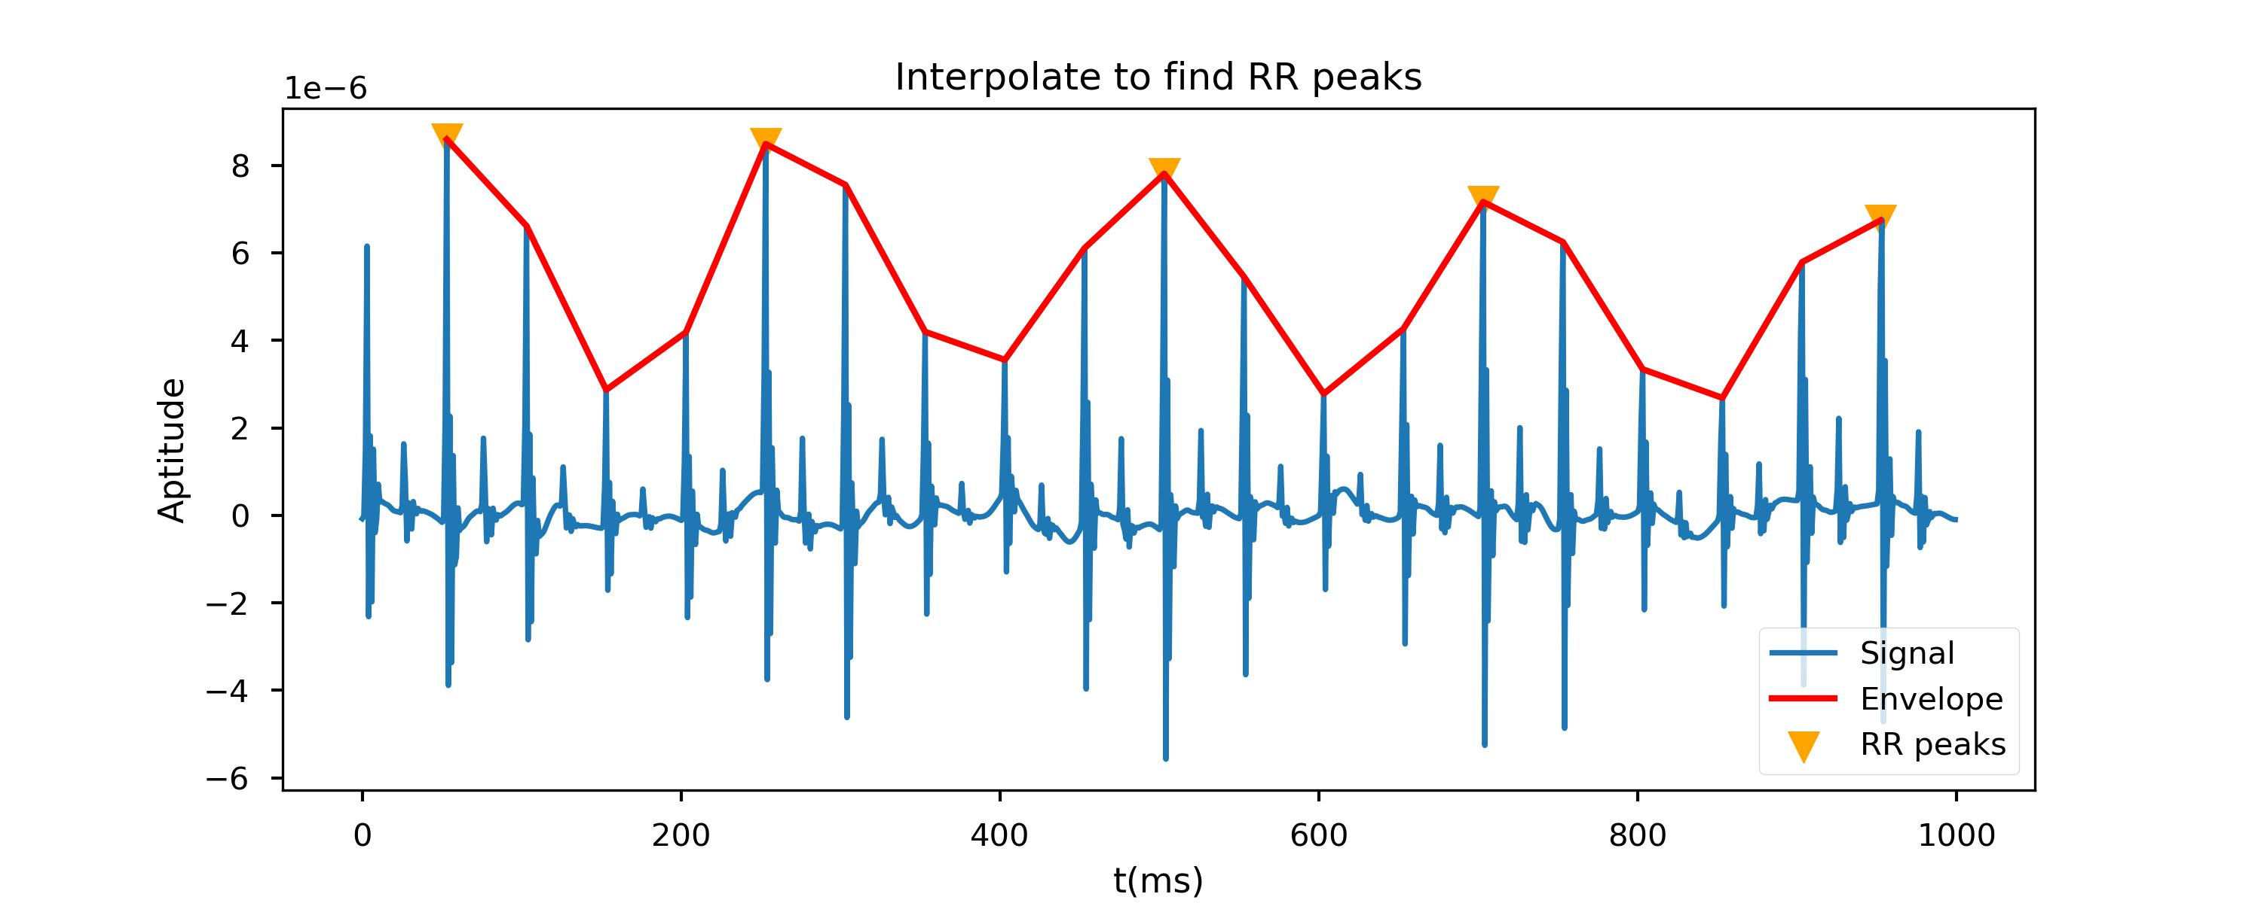
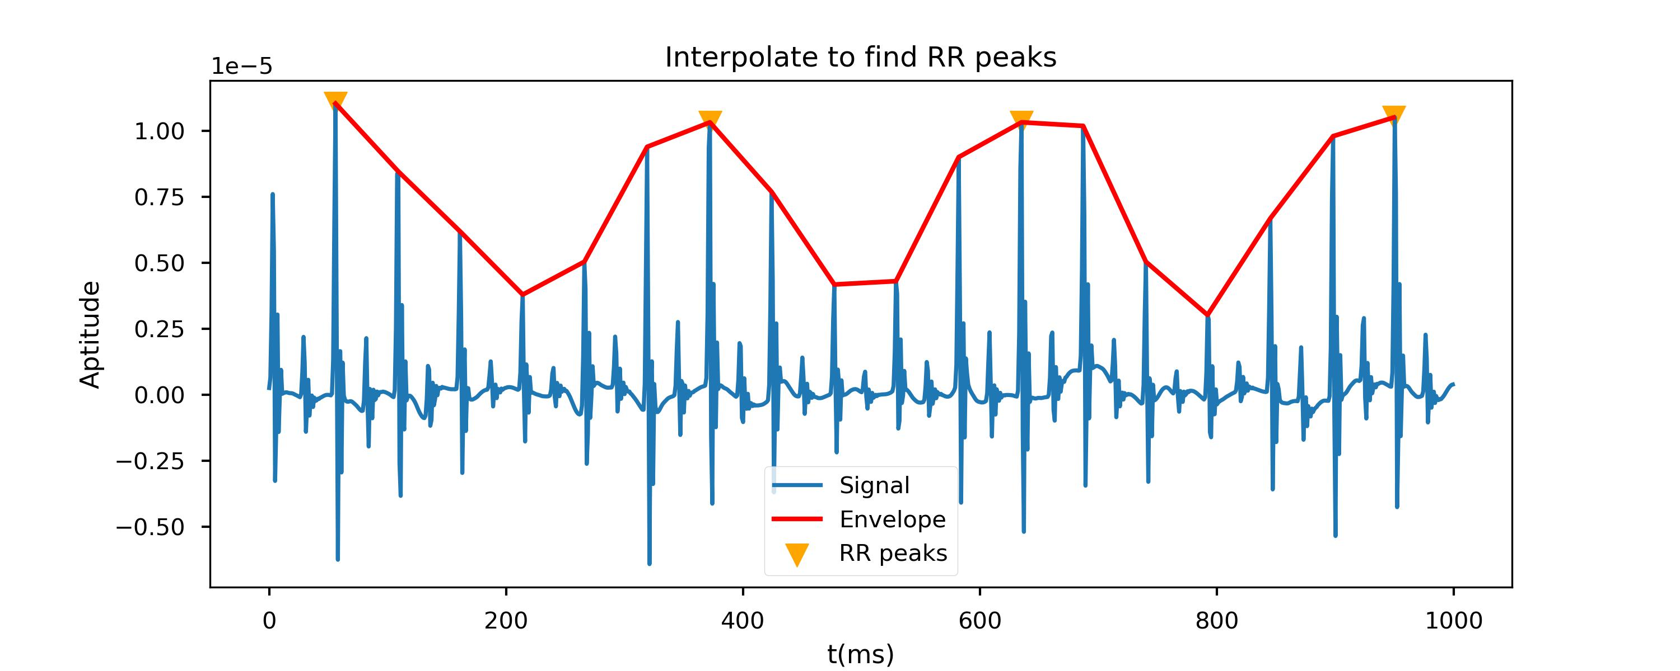
Work: Get Template Heartbeat Signal – Peaks Detection and HR&RR Estimation
Linear Interpolation
Detected HR Peaks
My approach for RR Estimation
Linear Interpolation
Linear
Interpolation
Zero Padding
Zero Padding
Predict values between two known data points
Peaks Detection
Extrapolation
RR Peaks
Predict values beyond the range of known data points
Notes:
第二个困难是：how get envelope by extrapolating the HR peaks?
Interpolate means Estimate values between two known data points
Extrapolate means estimate or predict values beyond the range of known data

Slide 10
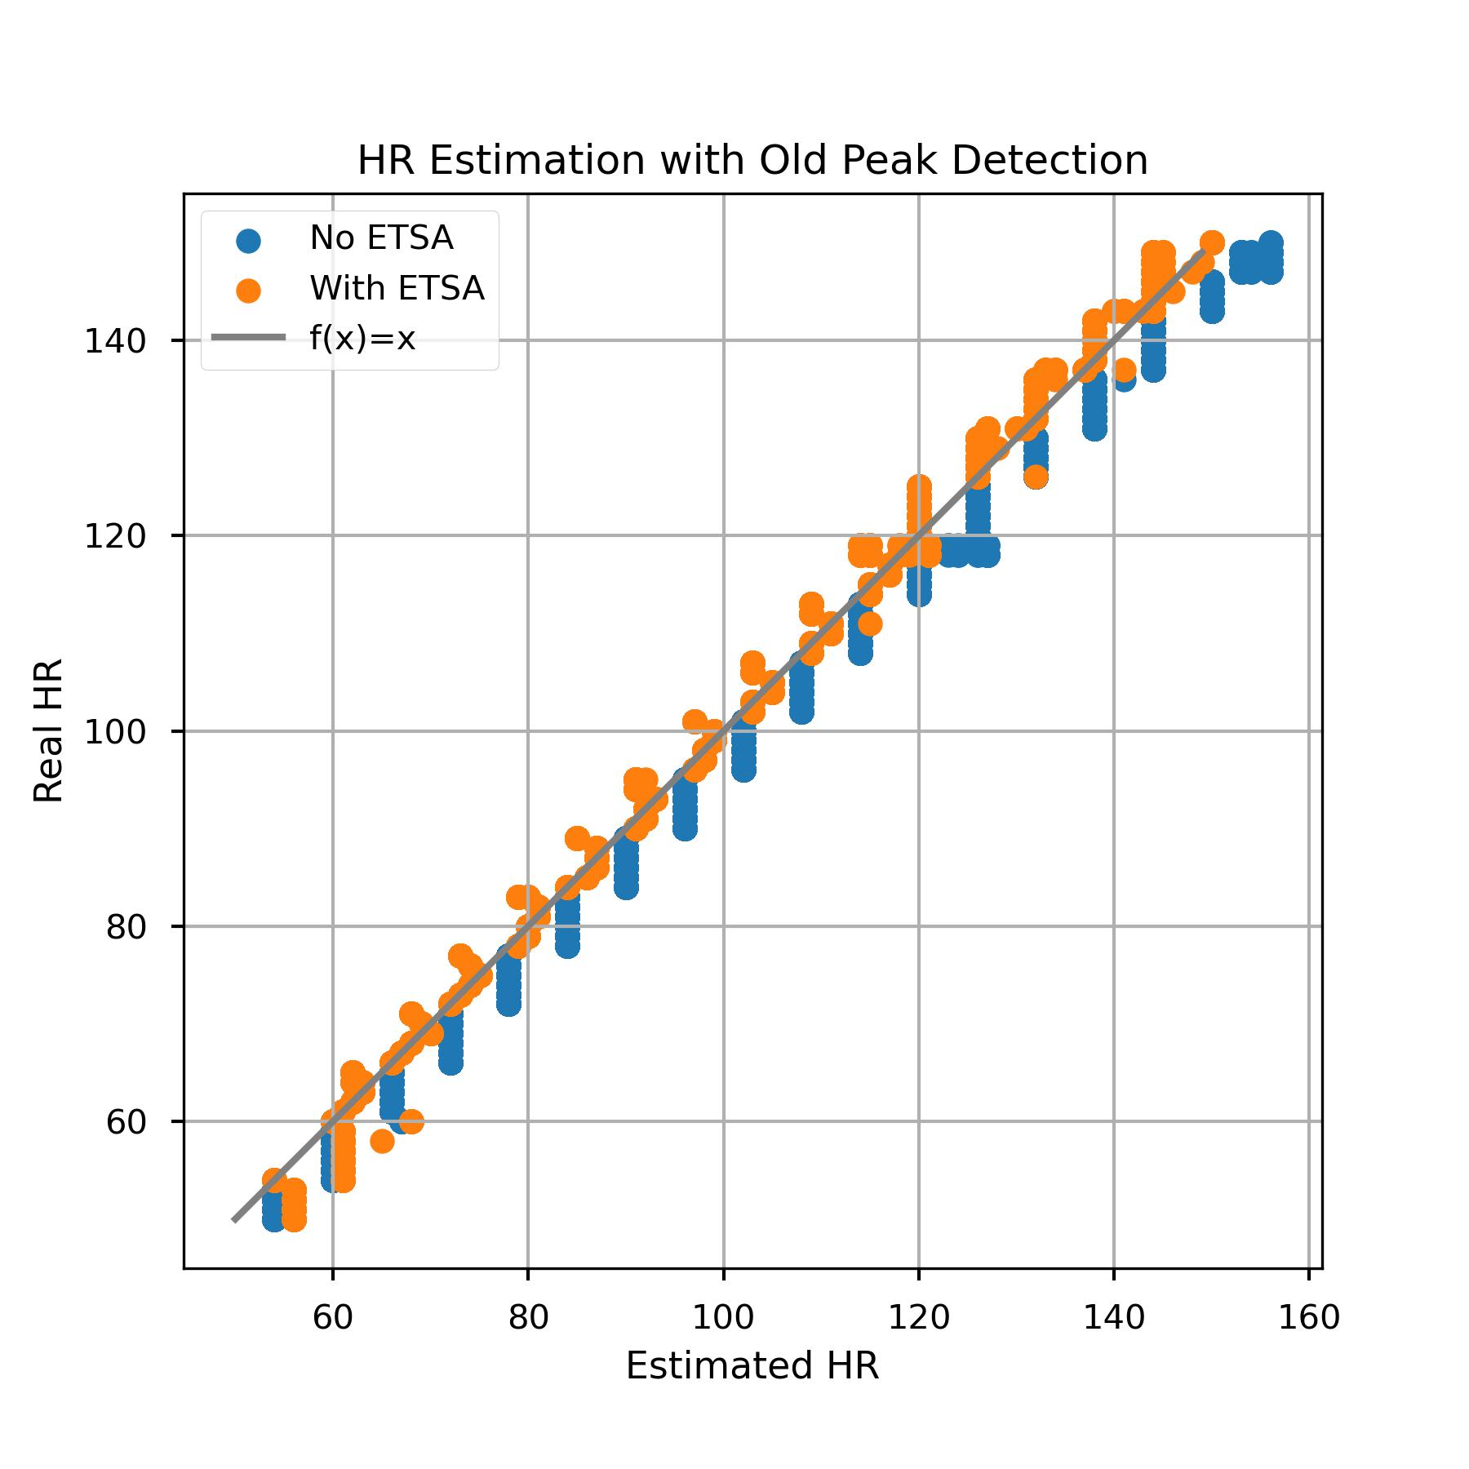
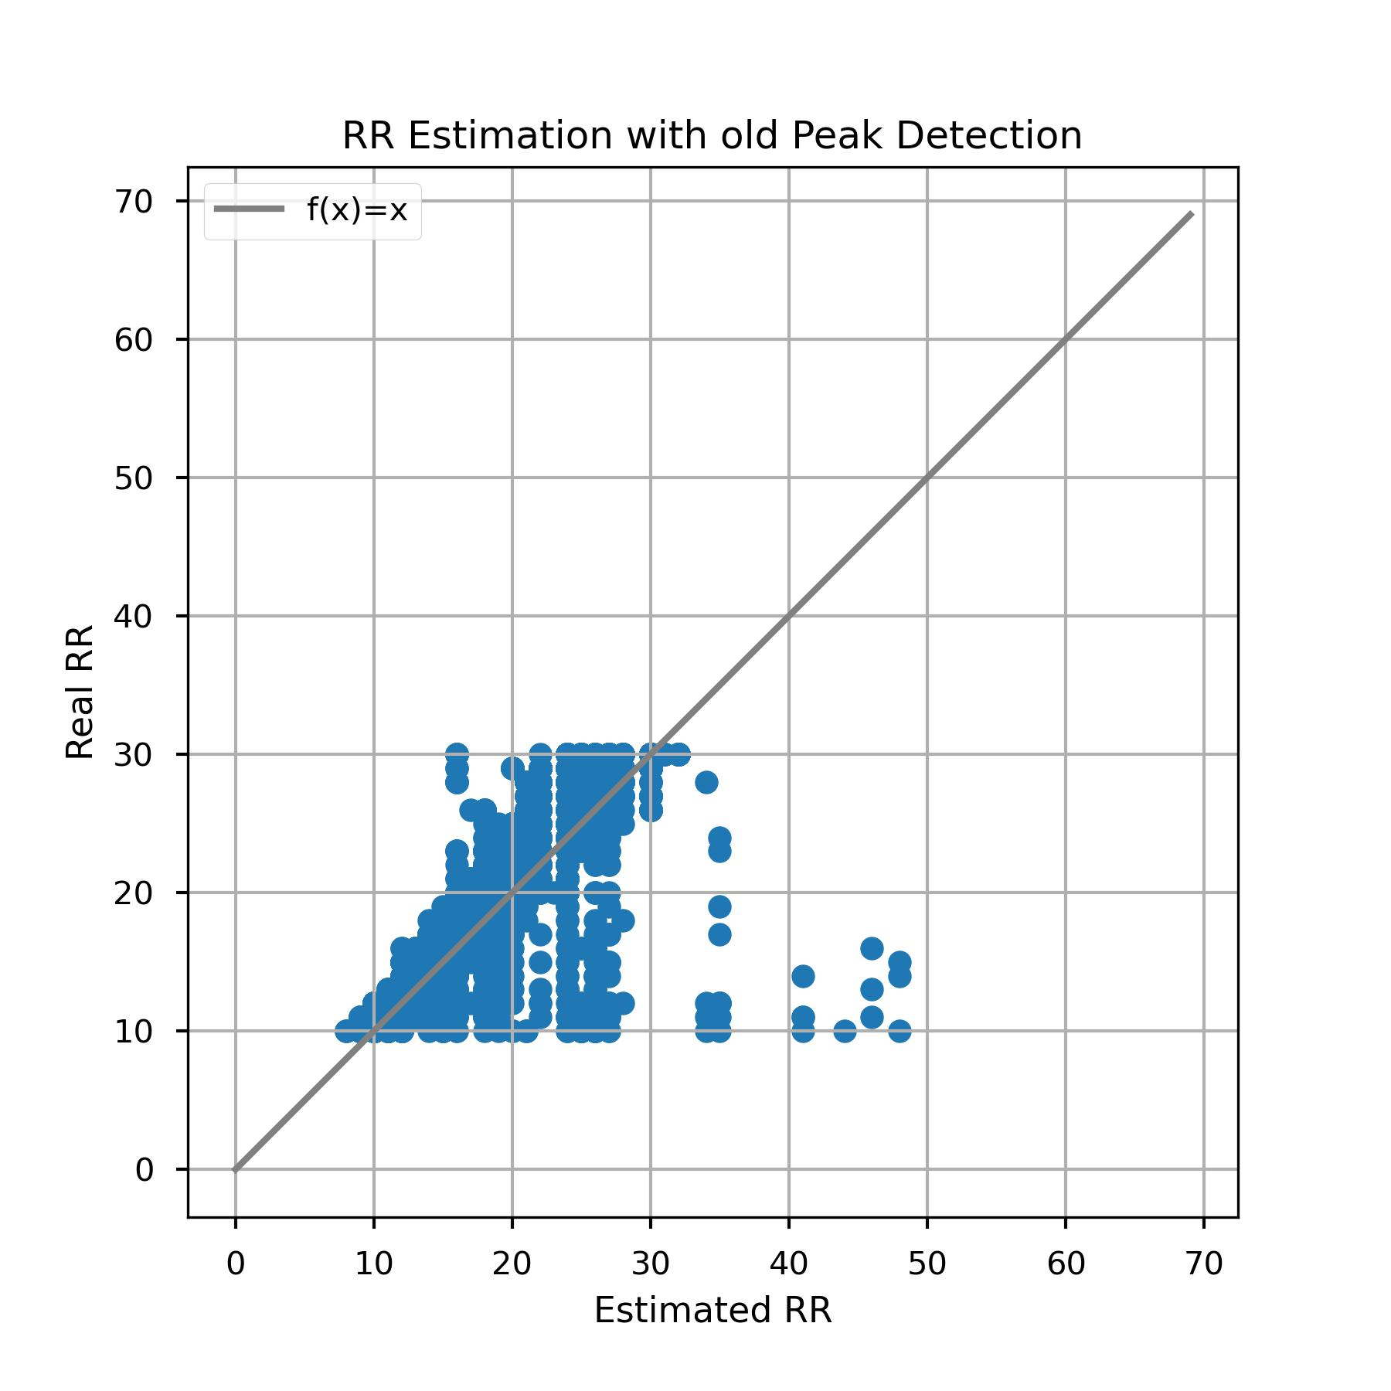
Work: Get Template Heartbeat Signal – Peaks Detection and HR&RR Estimation
HR & RR Estimation with Accurate HR Peaks Detection
Conclusions:
Empirical Truncated Statistics Analysis(ETSA) can really improve the performance.
Linear Interpolation for the envelope also works
Notes:
Let's take a look at the results.
These two charts are HR Estimation and RR Estimation respectively.
The horizontal axis represents Estimate values, and the vertical axis represents Real Values.
Let's start with the chart on the left.
Blue points indicate results without using the (ETSA),
while yellow points represent results with ETSA applied.
It's evident that there's a significant improvement, as the orange points are much closer to the line f(x) = x.
Let look at the chart on the right, the linear interpolation appears a bit rough, but overall, this method also works.

Slide 11
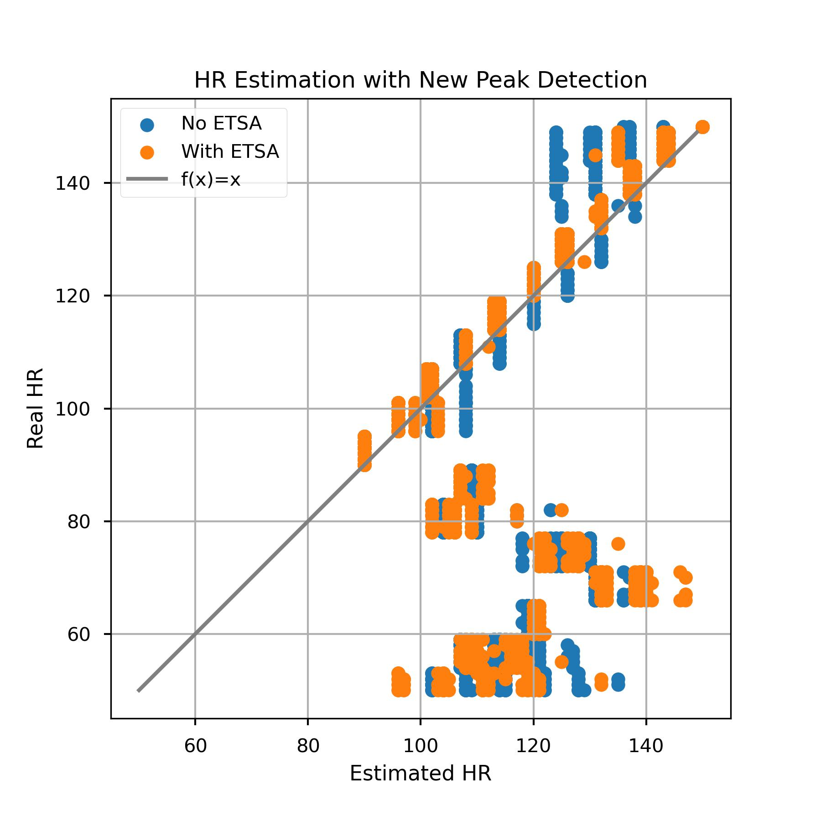
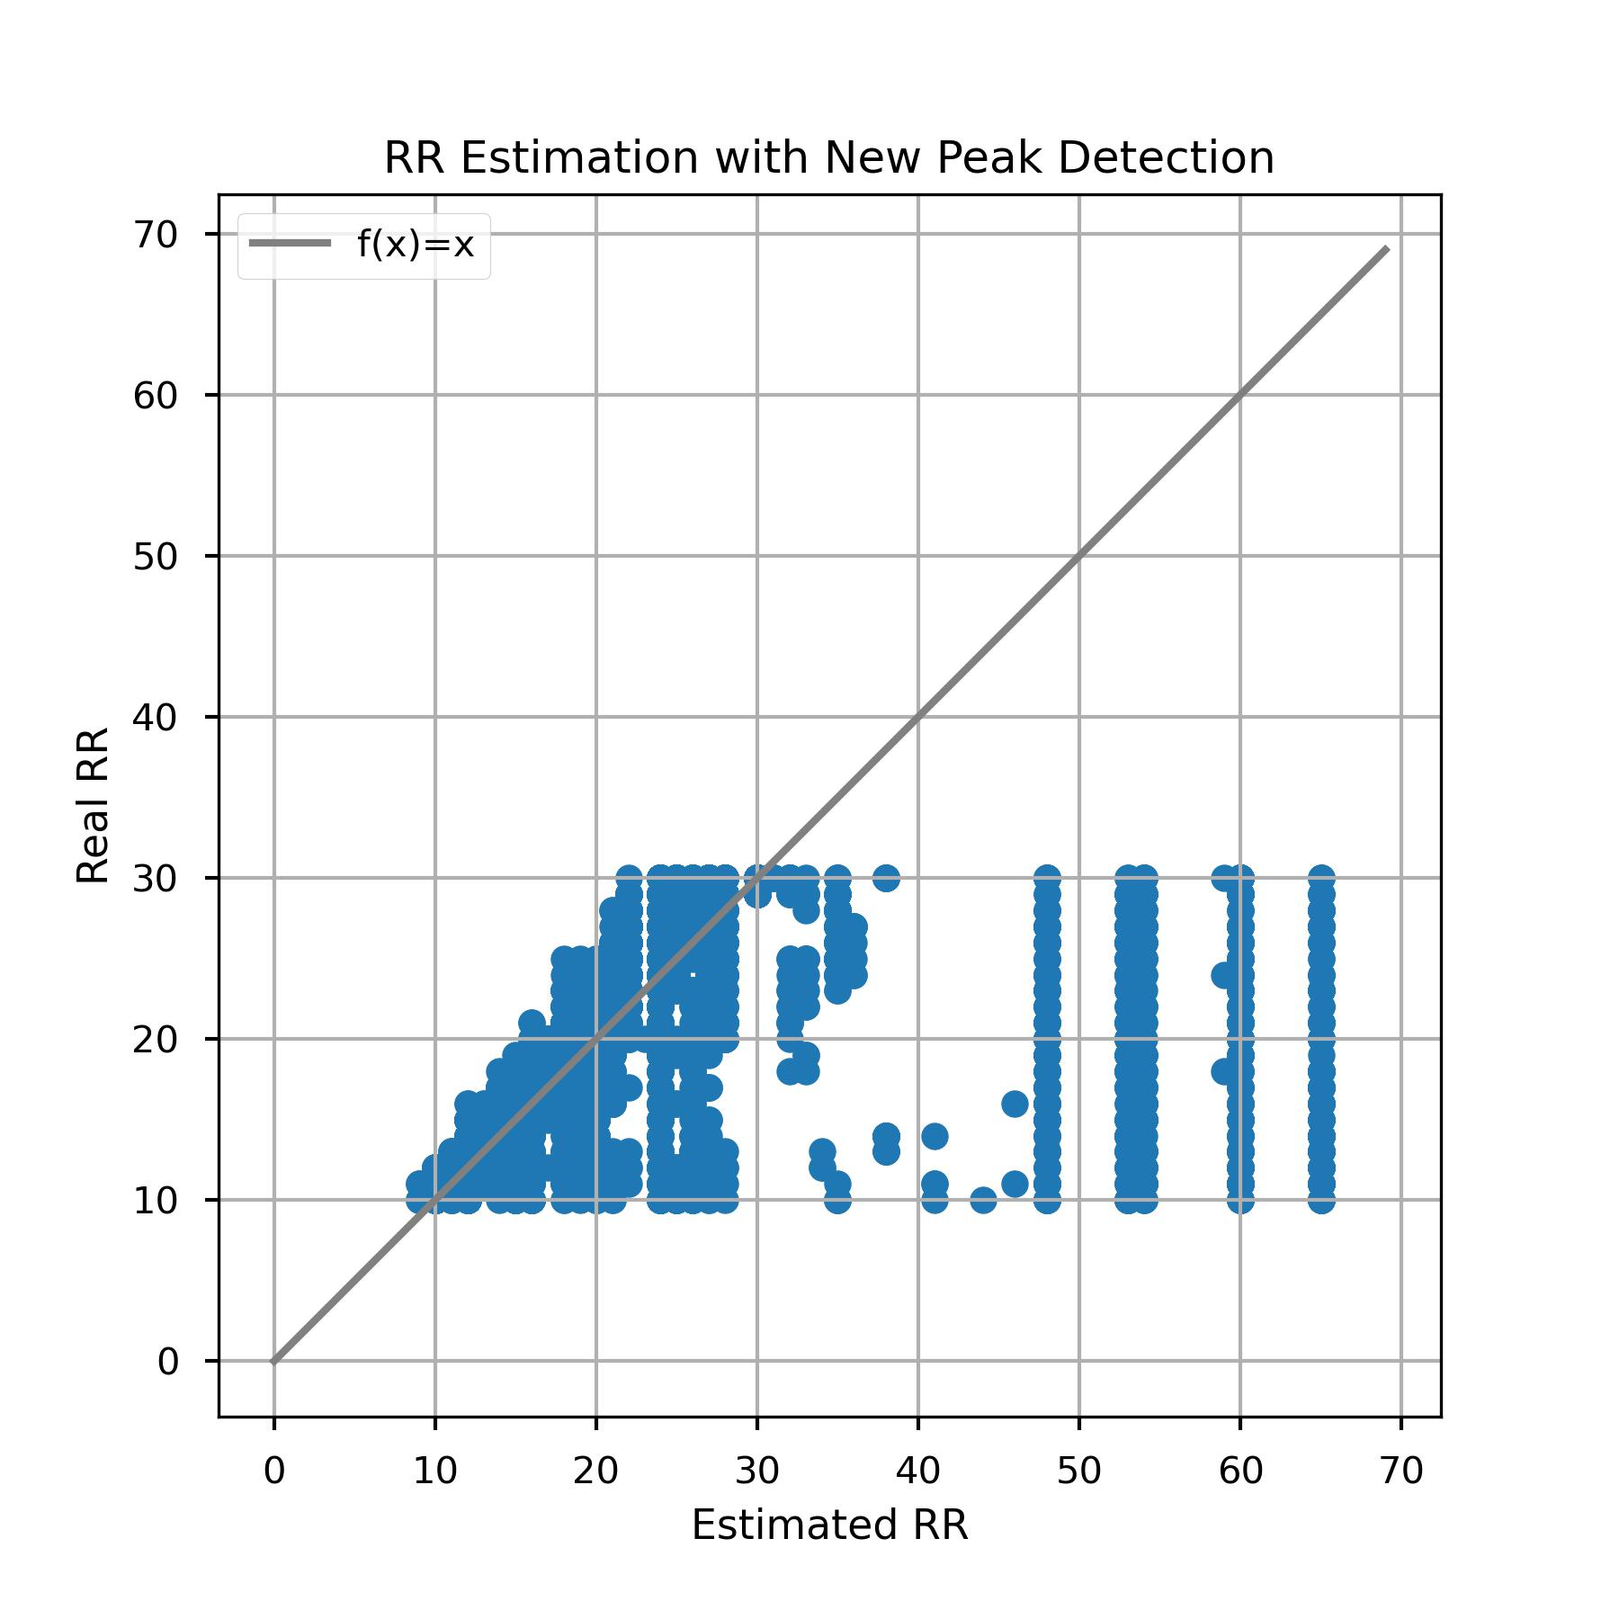
Work: Get Template Heartbeat Signal – Peaks Detection and HR&RR Estimation
HR & RR Estimation with Inaccurate HR Peaks Detection
Conclusions:
Empirical Truncated Statistics Analysis(ETSA) can be widely applied.
Accurate Detection of HR peaks is the core of the algorithm.
Notes:
The Results of "HR & RR Estimation with Inaccurate HR Peaks Detection."
Let's focus on the left image. Even with inaccurate peaks detection, ETSA still can optimize the estimation. You can see the yellow points are more close to the gray line.
This method can be widely applied.
From the comparison, We can see Accurate Detection of HR peaks is the core of the algorithm.

Slide 12
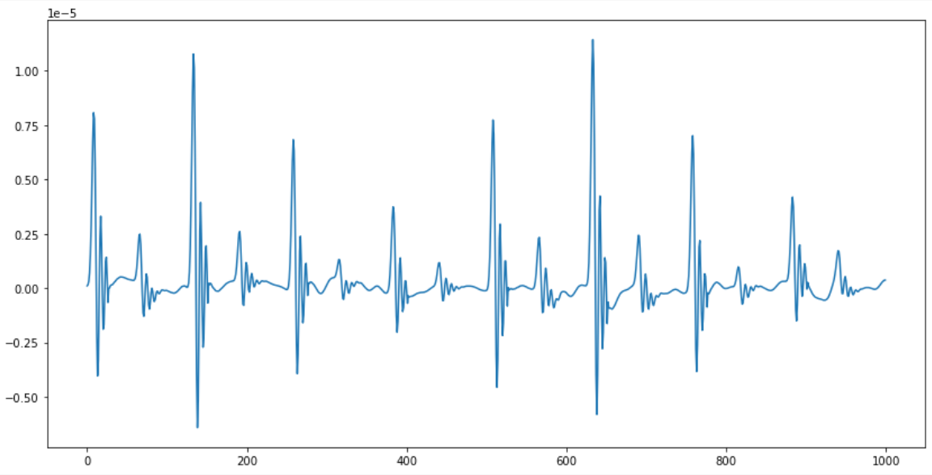
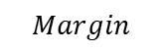
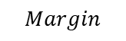
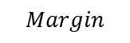
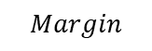
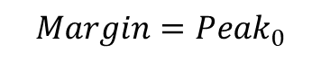
Work: Get Template Heartbeat Signal – Slice
Sliced by Margin
$$Margin$$
$$Margin$$
$$Margin$$
$$Margin$$
$$Margin$$
$$Margin=Peak_{0}$$
Advantages:
Small Peaks are reserved well.
Each segmented signal needs almost no padding.
One piece of sliced signal
Notes:
Below is the section about signal segmentation. I'm still using the algorithm I mentioned last week, "Sliced by margin," so I will not go into further detail about it.

Slide 13
Work: Get Template Heartbeat Signal – Clustering
Comparison
"Recursive Function"
def Kmeans_clustering(threshold, num_clusters):
. . . . . .
if any(cluster) > threshold:
result = . . .
return result
else:
return Kmeans_clustering(threshold, num_clusters-1)
K-Means Clustering
Specify the number of clusters
Hierarchical Clustering
def Hierarchical_clustering(threshold):
. . . . . .
result = . . .
return result
Threshold_1
No specify the number of clusters
Threshold_2
Threshold_3
Threshold_4
hierarchical tree
Notes:
After slicing the signals, we need to stack them.
Last week, I used the averaging method. Then, Professor Song, you provided us a paper.
This paper mentioned using clustering for obtaining the template signal.
However, the specific type of clustering is not mentioned in the paper.
I tried two clustering methods: K-means and hierarchical clustering.
Let's make a comparison between K-means and hierarchical clustering:
K-means needs to specify the number of clusters. So the code needs to be programmed in a recursive manner. as illustrated in the pseudo code on the right.
If any cluster is over the threshold, we can obtain the result.
If none of the clusters meet the threshold, then the recursion is executed, and the number of clusters is decreased.
So, Kmeans requires running many times until it meets the threshold we set.
Hierarchical clustering:
Doesn’t need to specify the number of clusters, and only needs to be run once.
because It constructs a hierarchical tree, and no matter what threshold you set, it can always find the desired clusters.

Slide 14
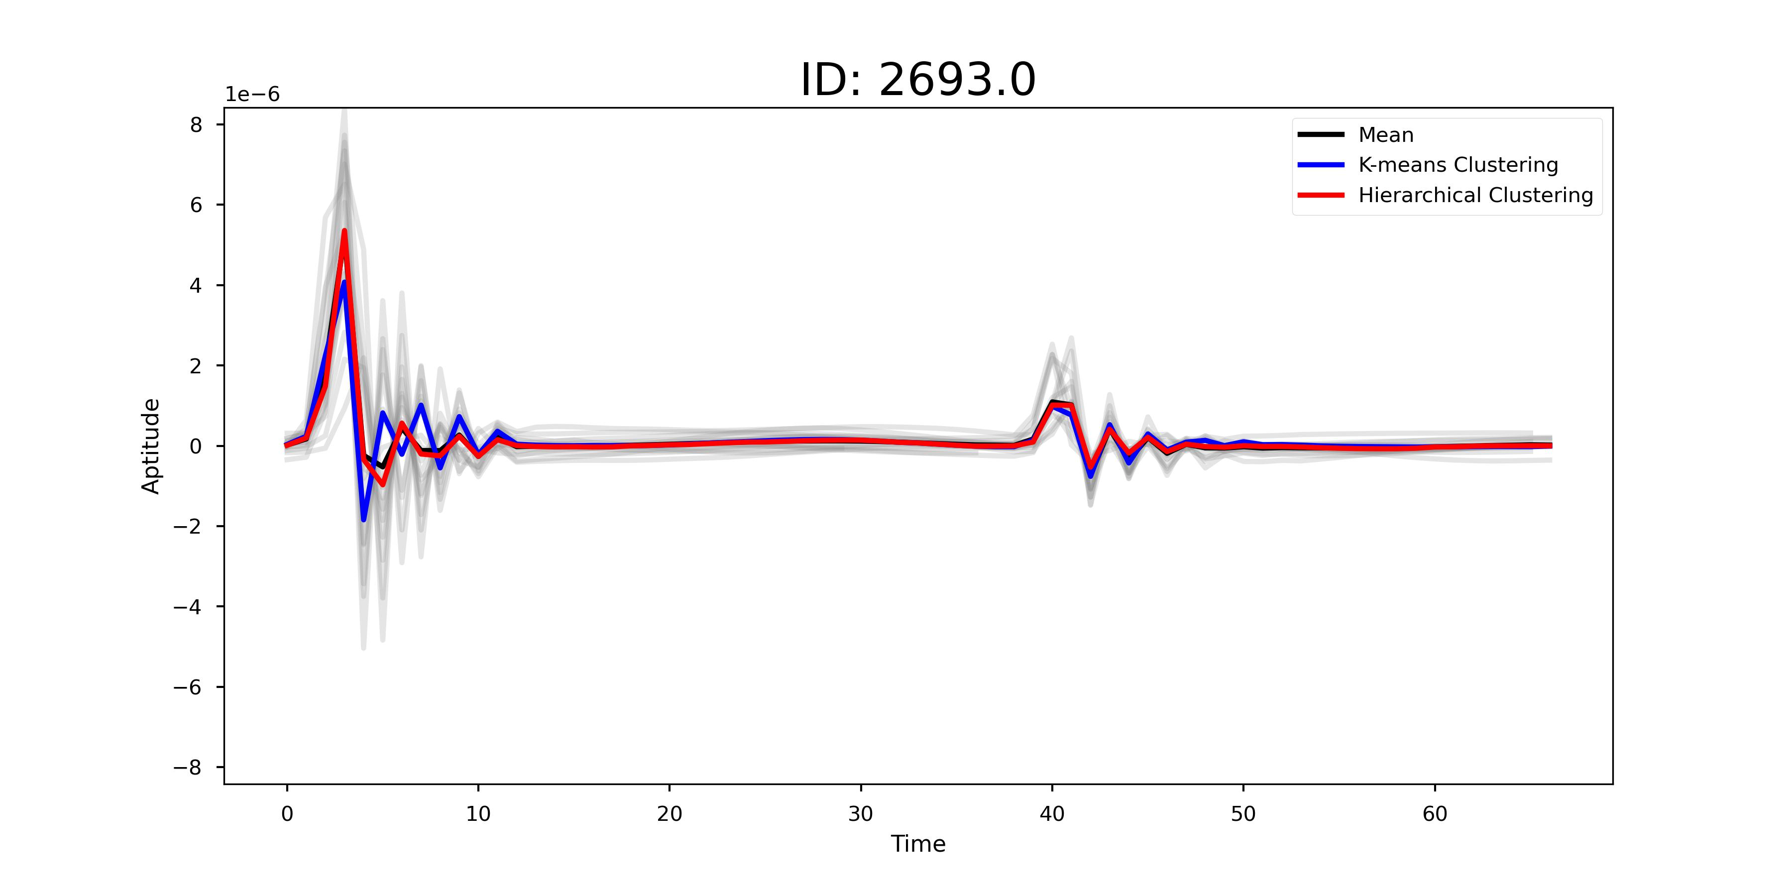
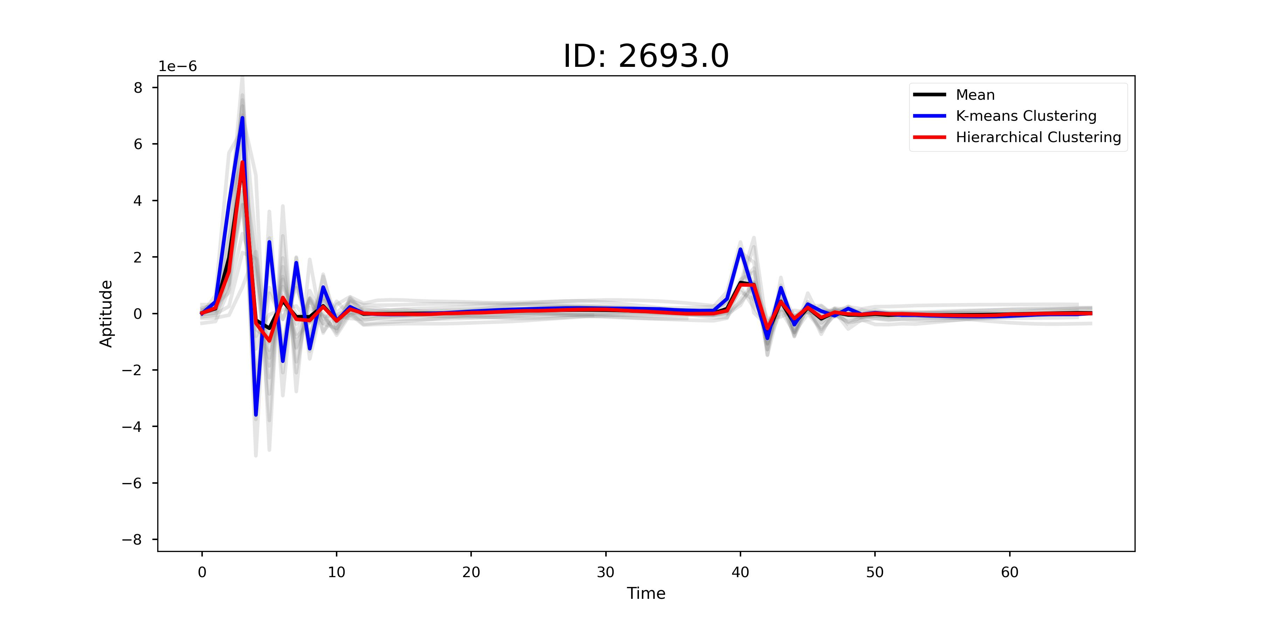
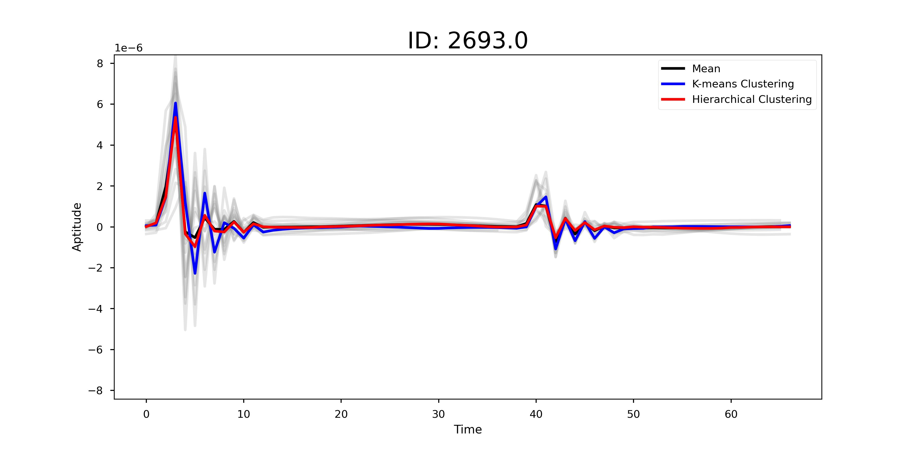
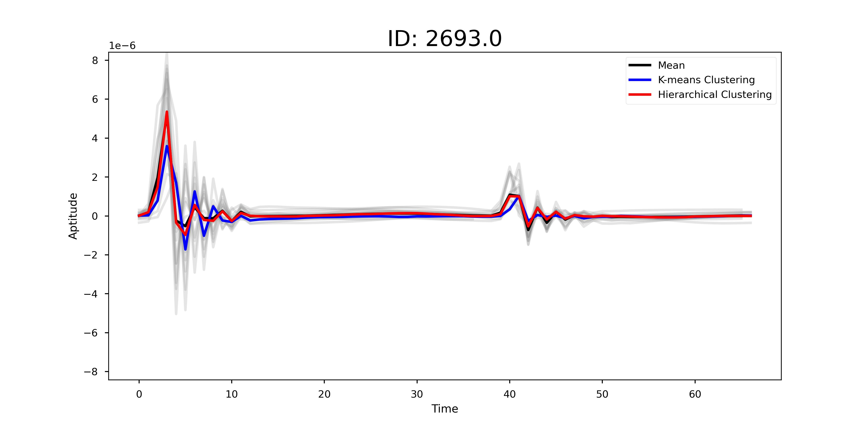
Work: Get Template Heartbeat Signal – Clustering
Comparison
Run a segment of code 5 times
K-means Clustering
Initialization of cluster centers has a great impact to results.
Hierarchical Clustering
Robust to random
initialization
Notes:
I ran a segment of code 5 times, conducting 5 clustering operations.
In the pictures, the blue lines represent K-means clustering, while the red lines represent hierarchical clustering.
It is clear that:
After running five times, K-means showed four different outcomes.
In contrast, the results of hierarchical clustering remained remarkably stable.
As to the Kmeans clustering, Initialization of cluster centers has a great impact to final results.

Slide 15
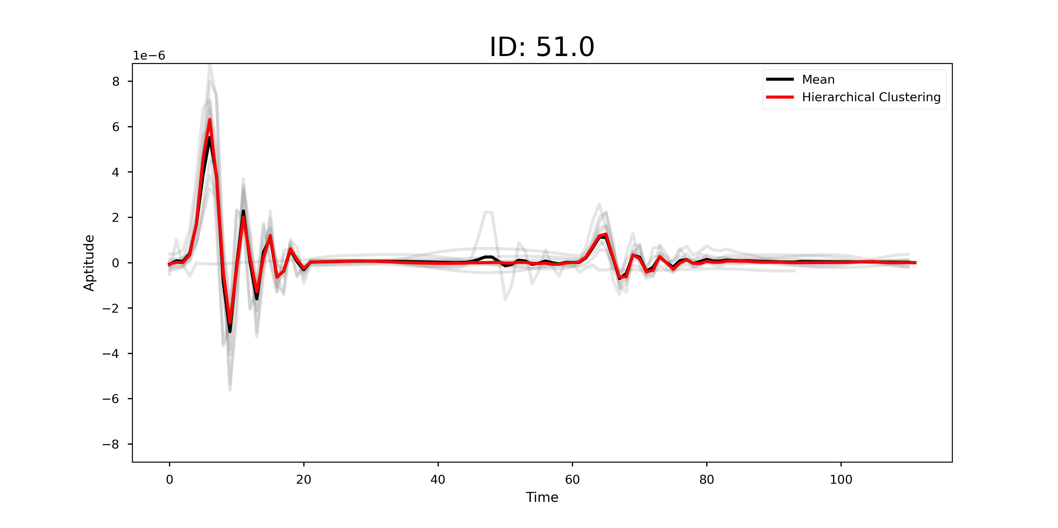
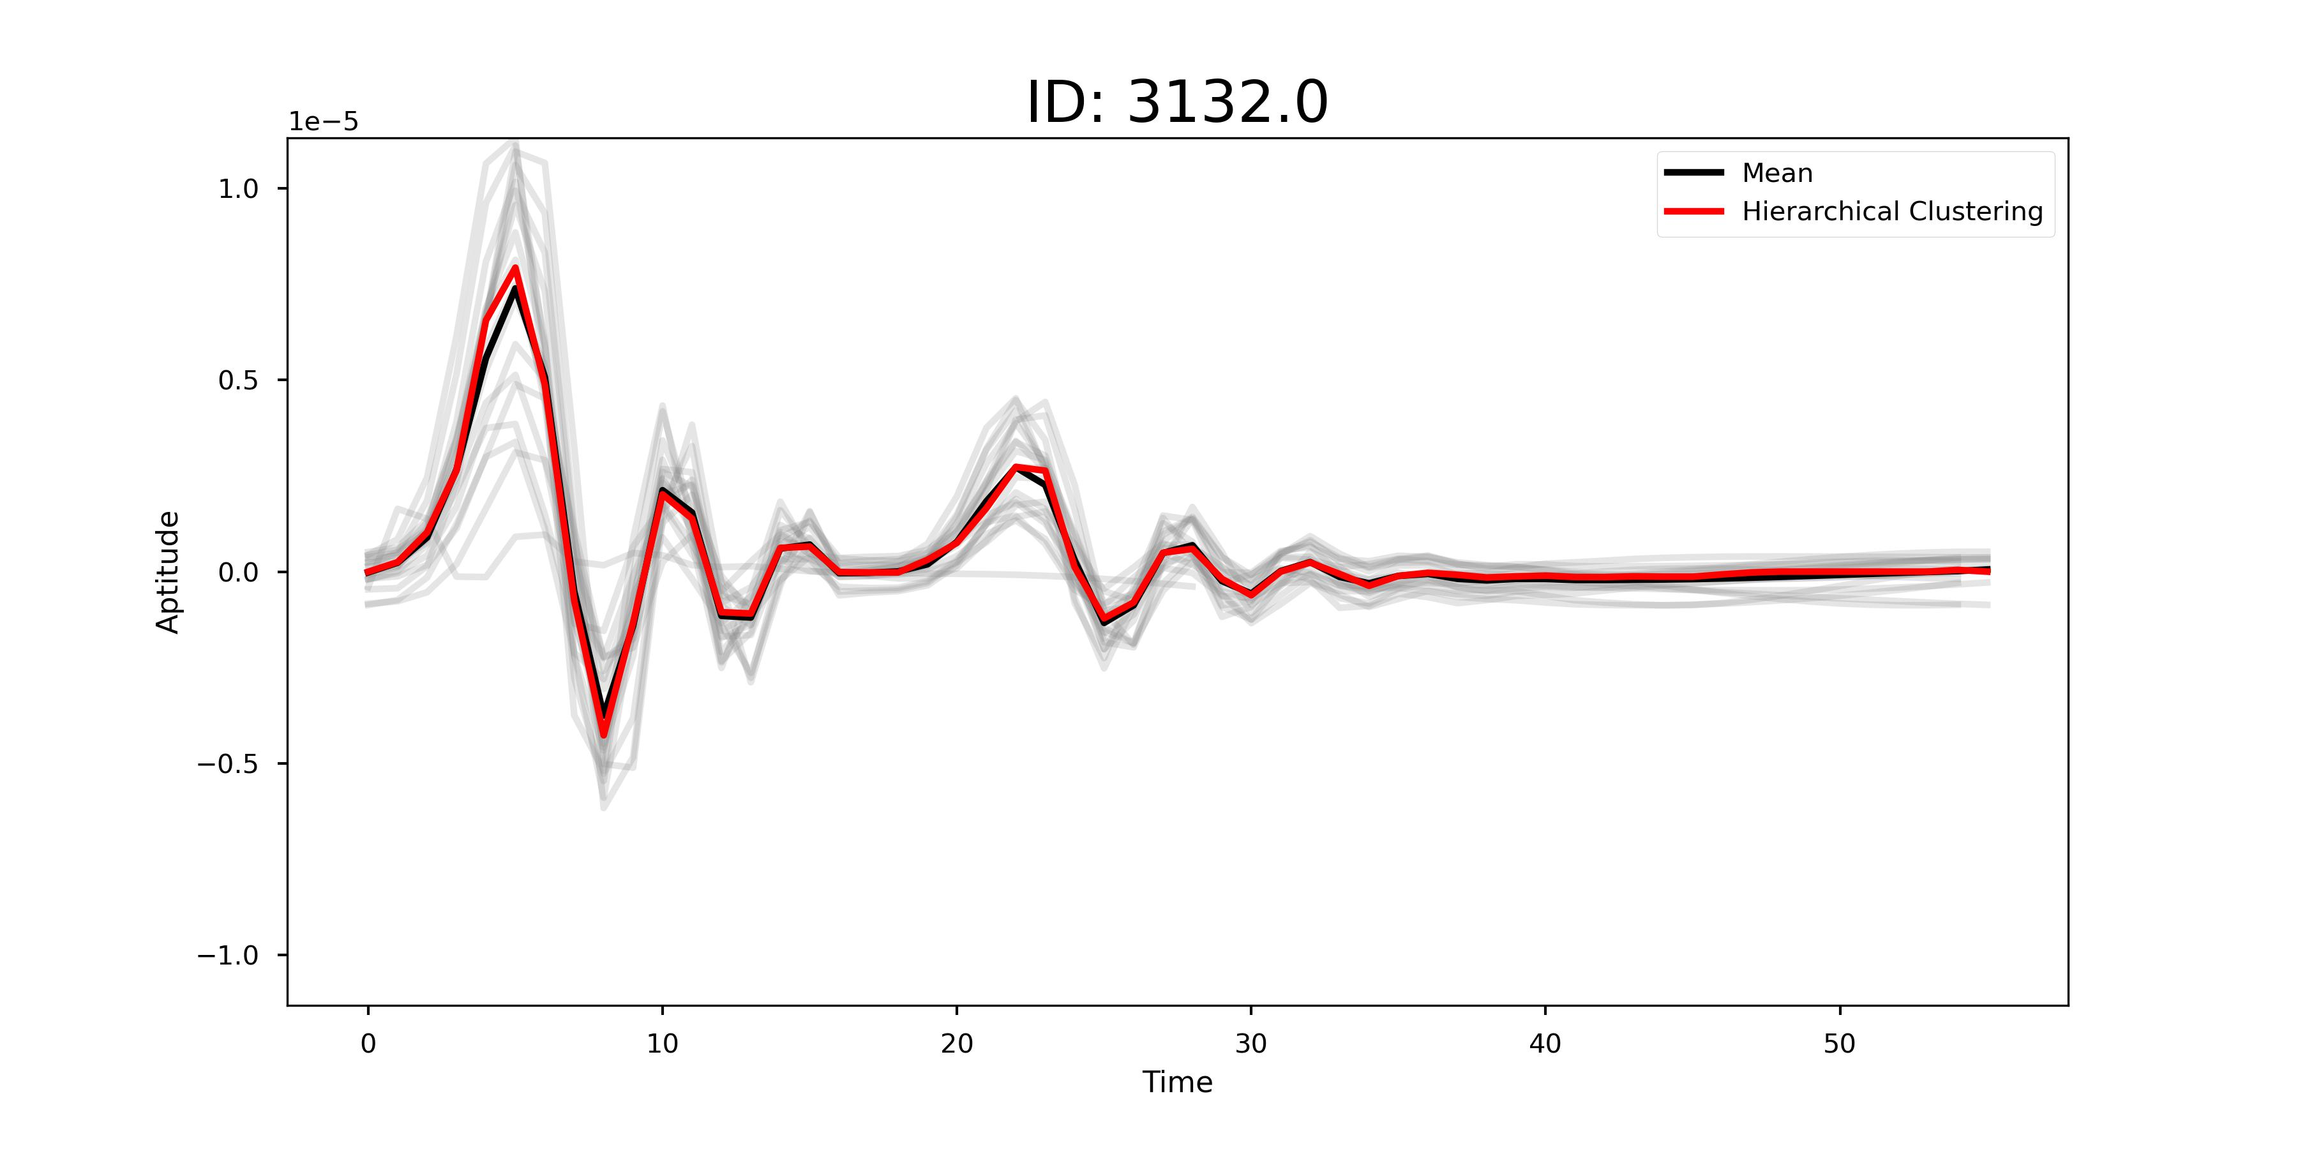
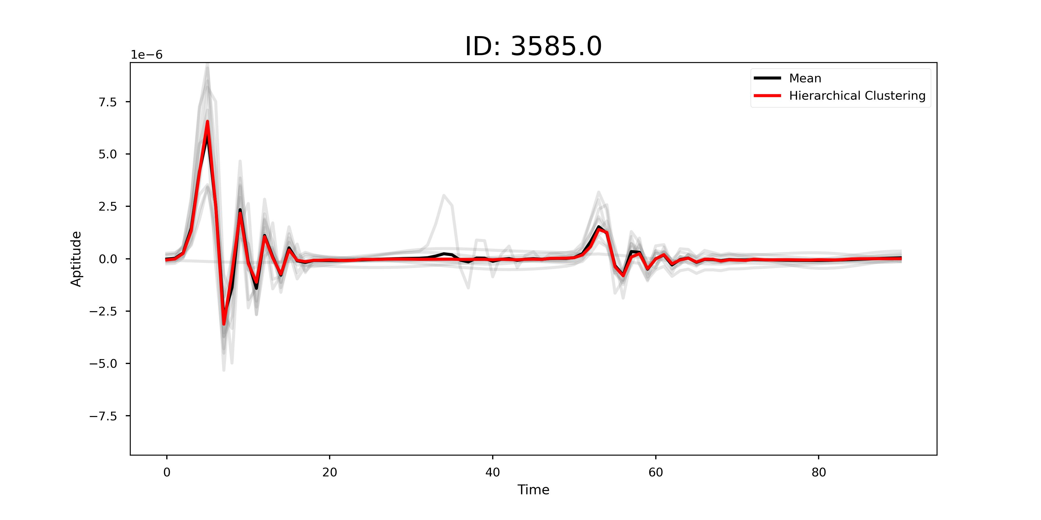
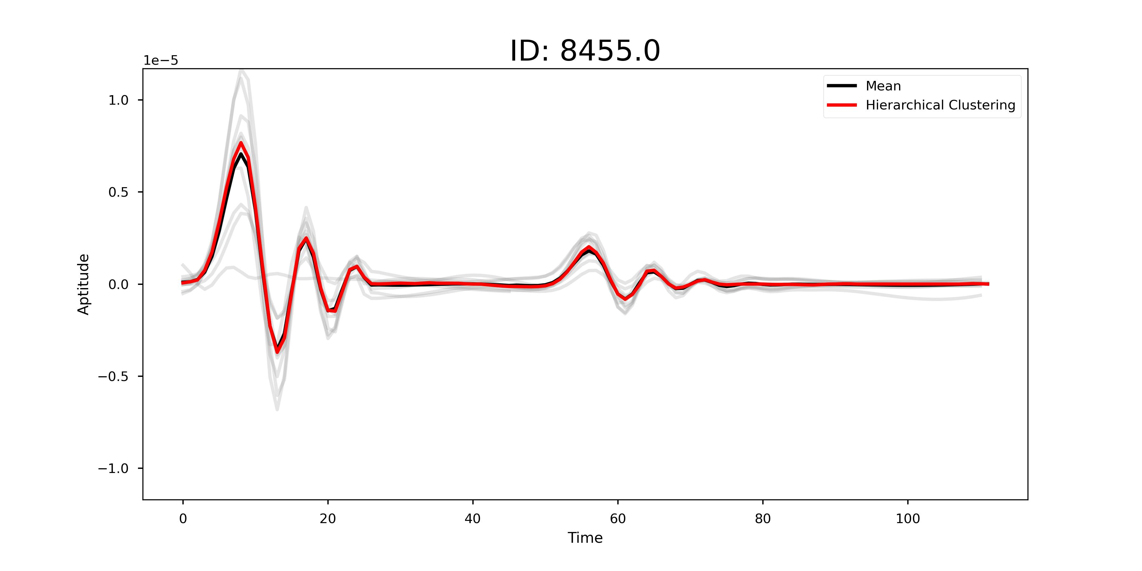
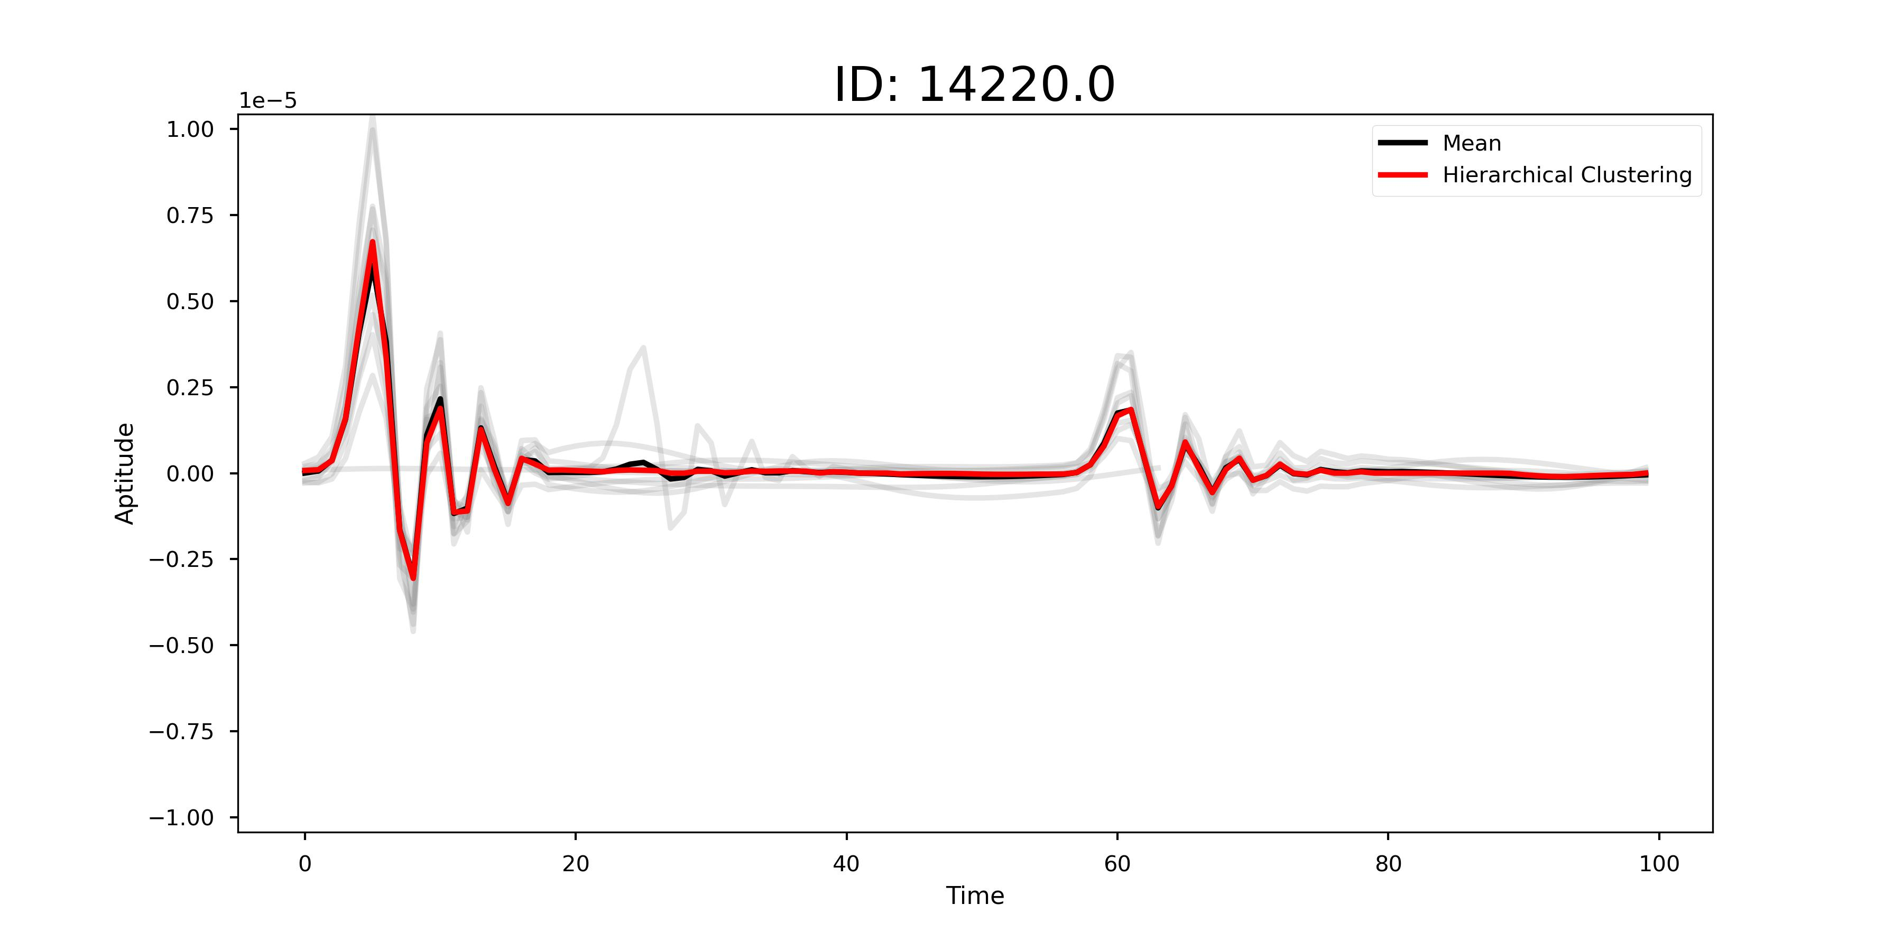
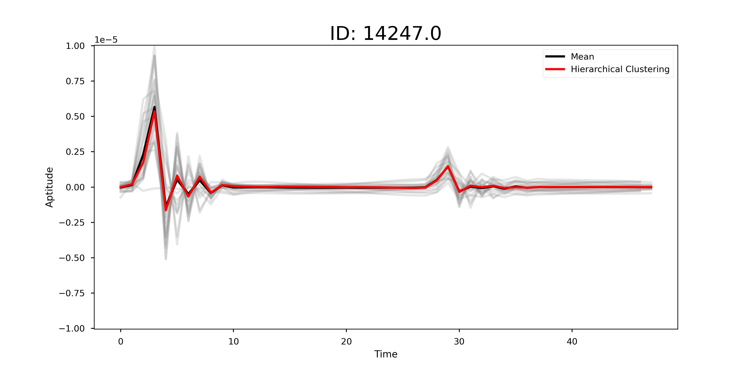
Work: Get Template Heartbeat Signal – Clustering
Clustering can filter out anomalous data, ensuring the quality of data.
Anomalous Data
Notes:
Because K-means shows fluctuations, I have only displayed hierarchical clustering in these plots.
Clustering can filter out anomalous data, ensuring data quality.
In the left three plots, the "Mean" and "Clustering" methods show consistent results.
Furthermore, from the right three plots, it is evident that when meeting anomalous signals or incorrect segmentations, the black lines show fluctuations.
On the other hand, red lines remain stable and unaffected by anomalous data.
Through clustering, anomalous data and normal signals are separated, resulting in the extraction of valid signals.

Slide 16
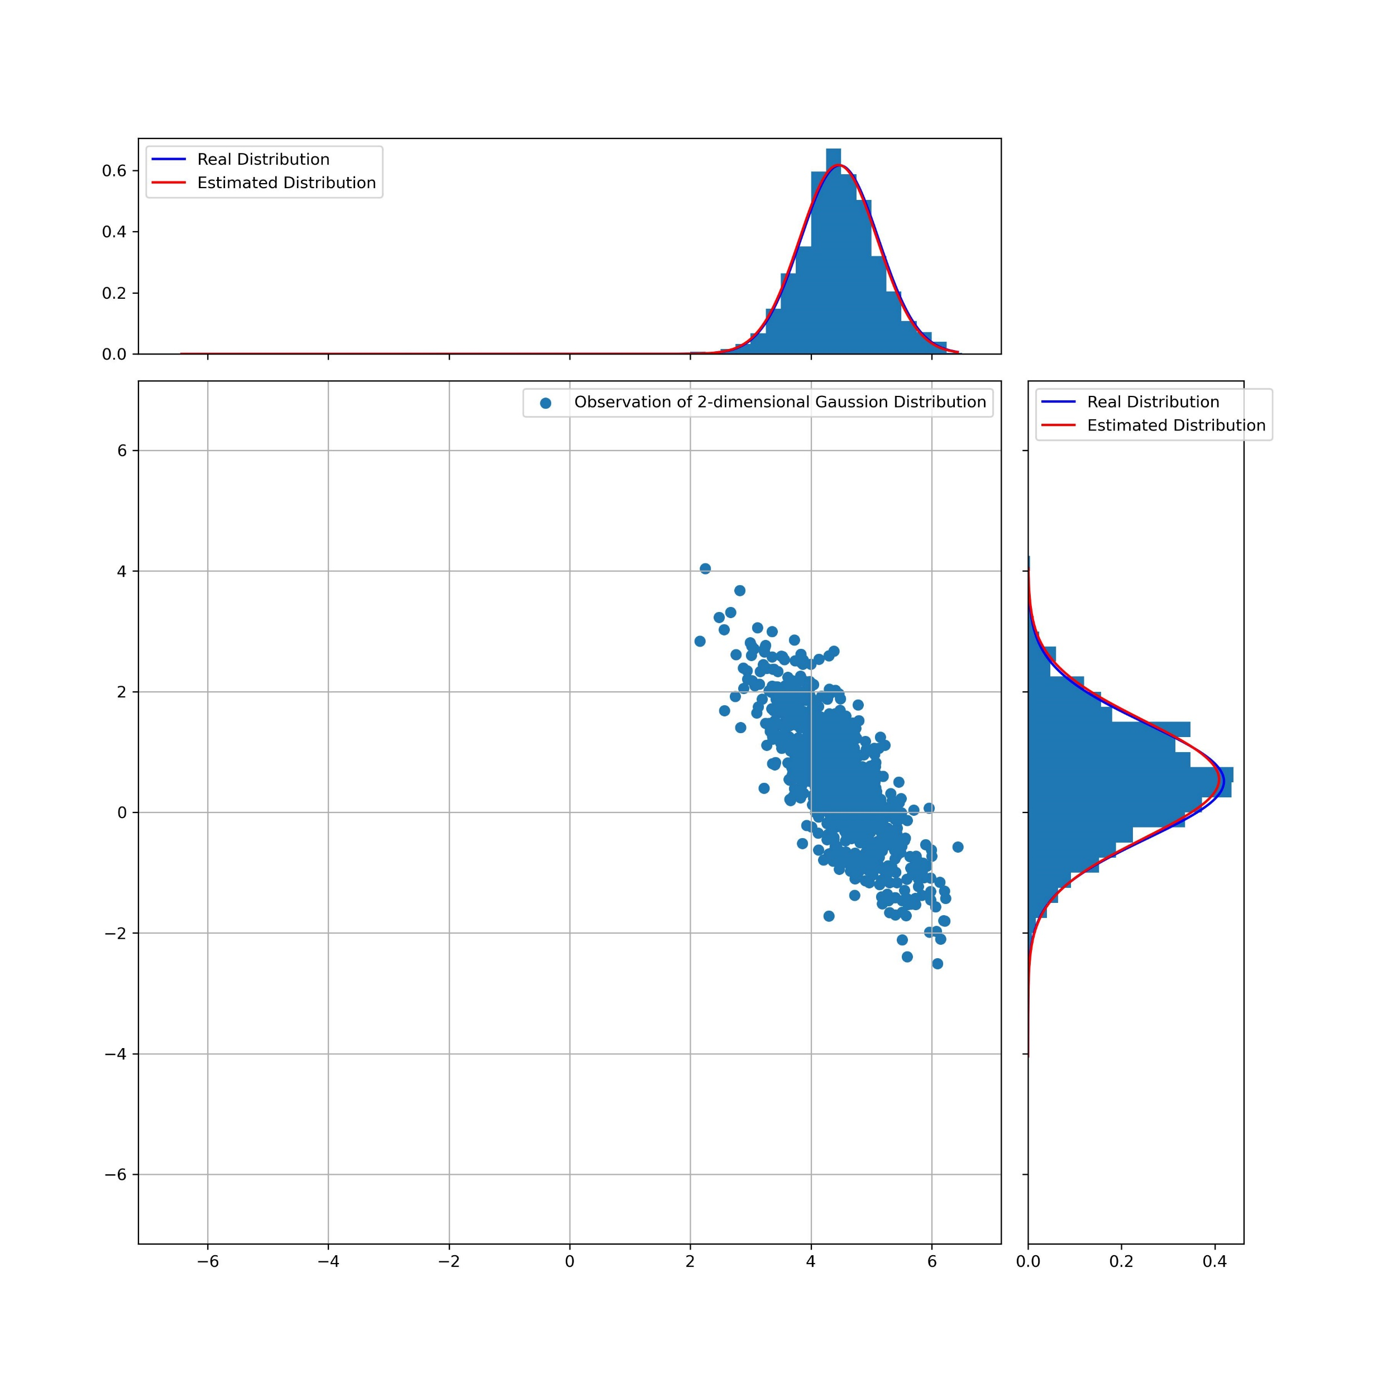
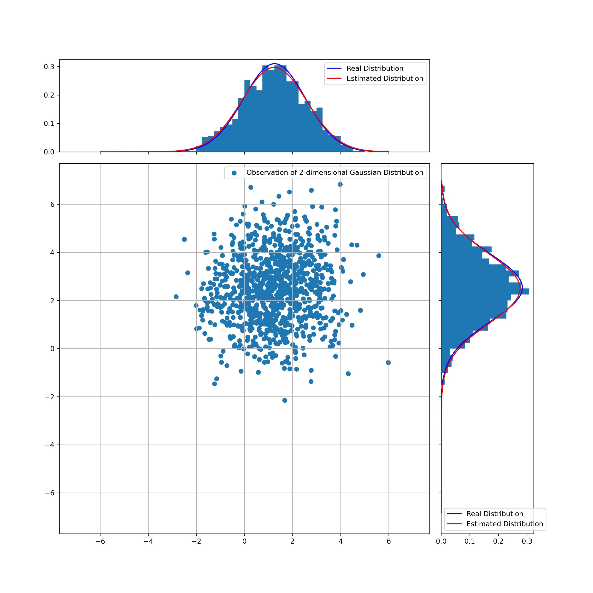
Work: Tutorial-ML Estimation
Given a P-dimensional Gaussian vector process y(m) from N observation vectors [y(0), y(1), ... , y(N − 1)].
Using Maximum likelihood estimation to get the mean vector and the covarance matrix.
My Tutorial:
Derivation of formulas,
which are omitted in book
Write code to simulte 2-D Gaussian process
Compare real Mean and Var
with the Mean and Var calculated by ML Estimation
Notes:
Next work is about max Likelihood estimation
I will give it quick introduction.
We have N observations of a P-dimension gaussian distribution.
What we need to do is Using Maximum likelihood estimation to get the mean vector and the covarance matrix of this P-D Gaussian distribution.

Slide 17
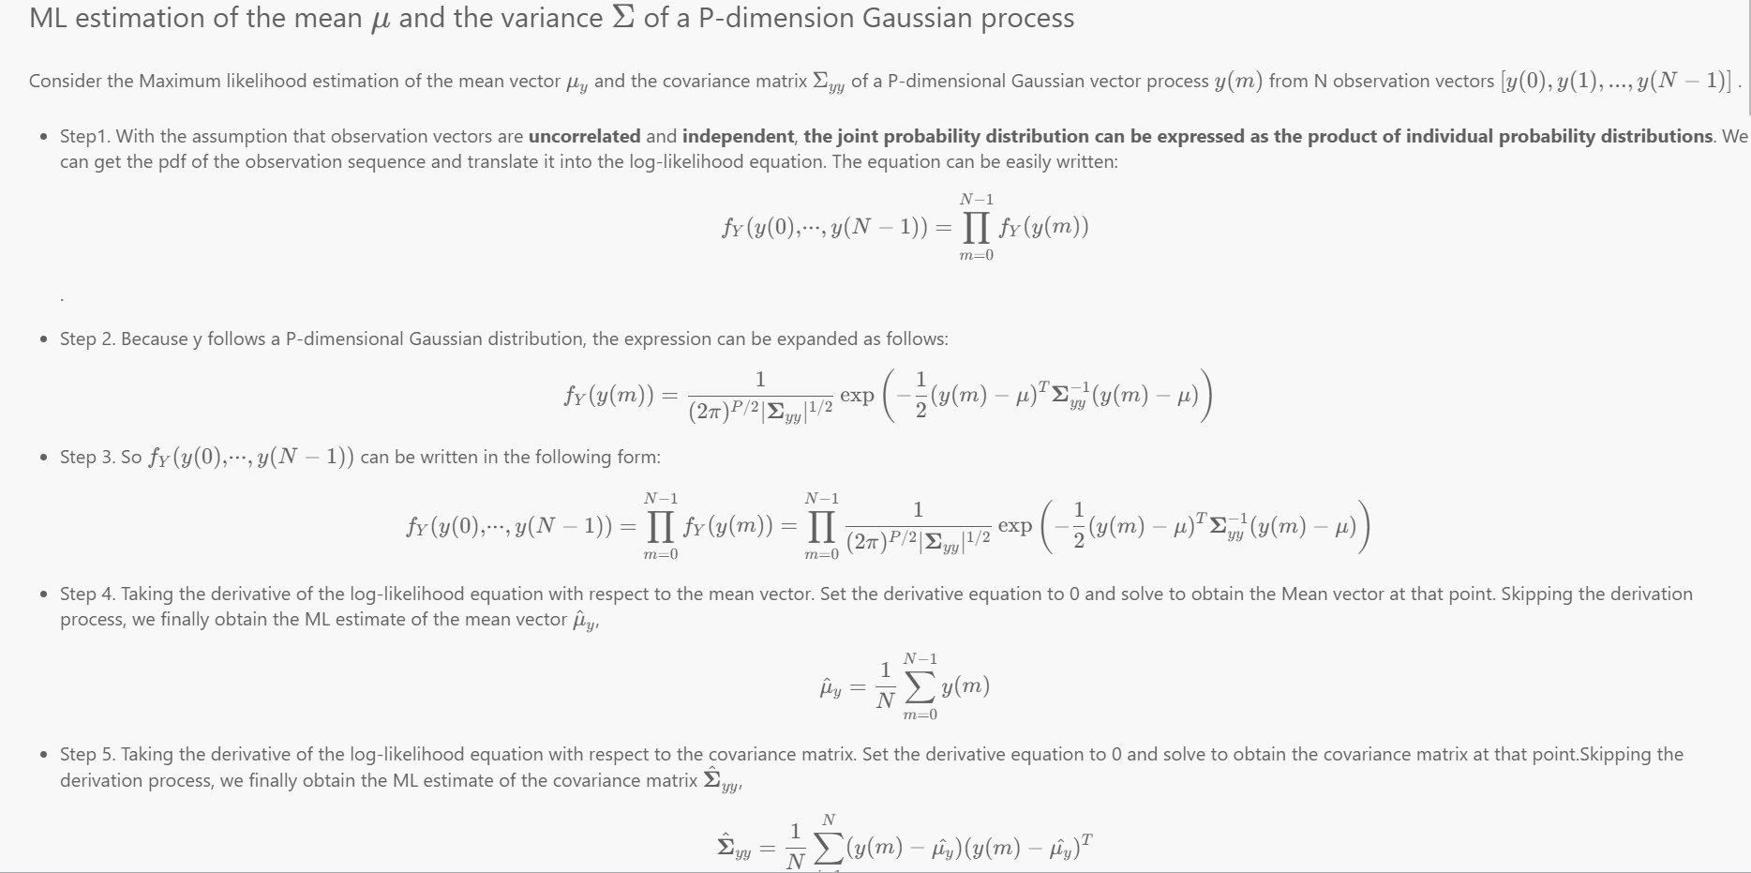
Work: Tutorial-ML Estimation
Emphasize some details that are overlooked in the textbook
Provide additional steps for the derivation of equations.
Time-consuming.
Parts of the tutorial I wrote
Notes:
I don’t know how to write high quality tutorials about Baysian inference. There are all formulas.
If I write some derivation of formulas. It is time-consuming.
If I only write the simulation code, without these texts and formulas, nobody will know what I’m doing.

Slide 18
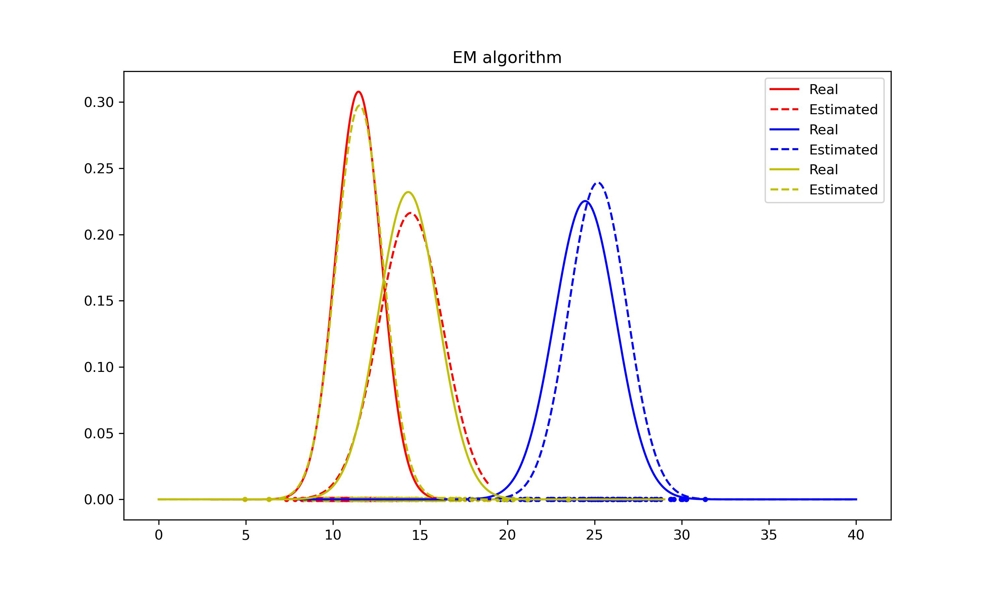
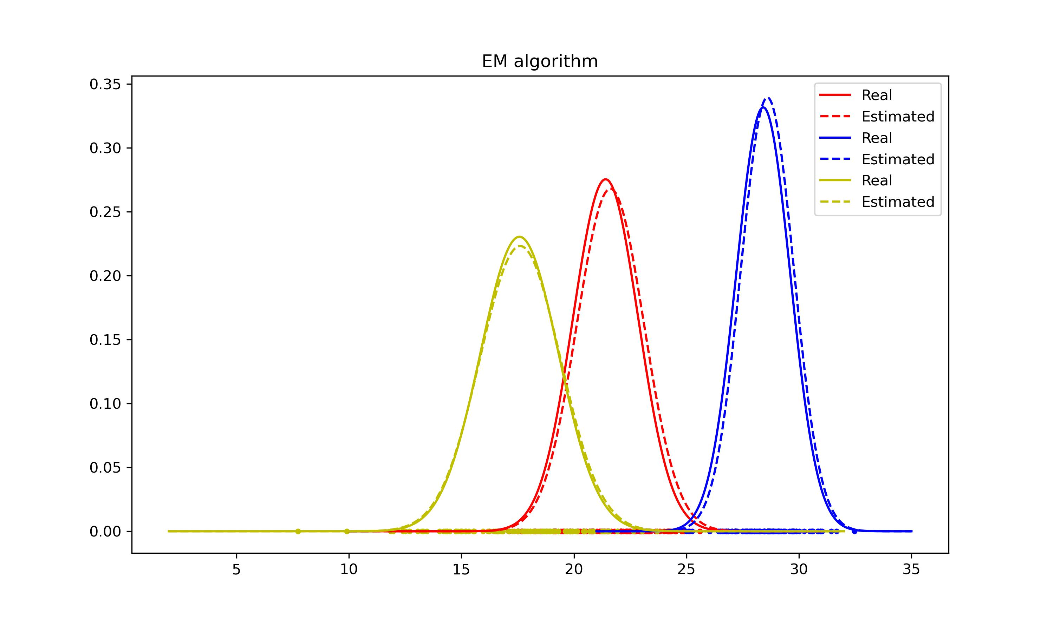
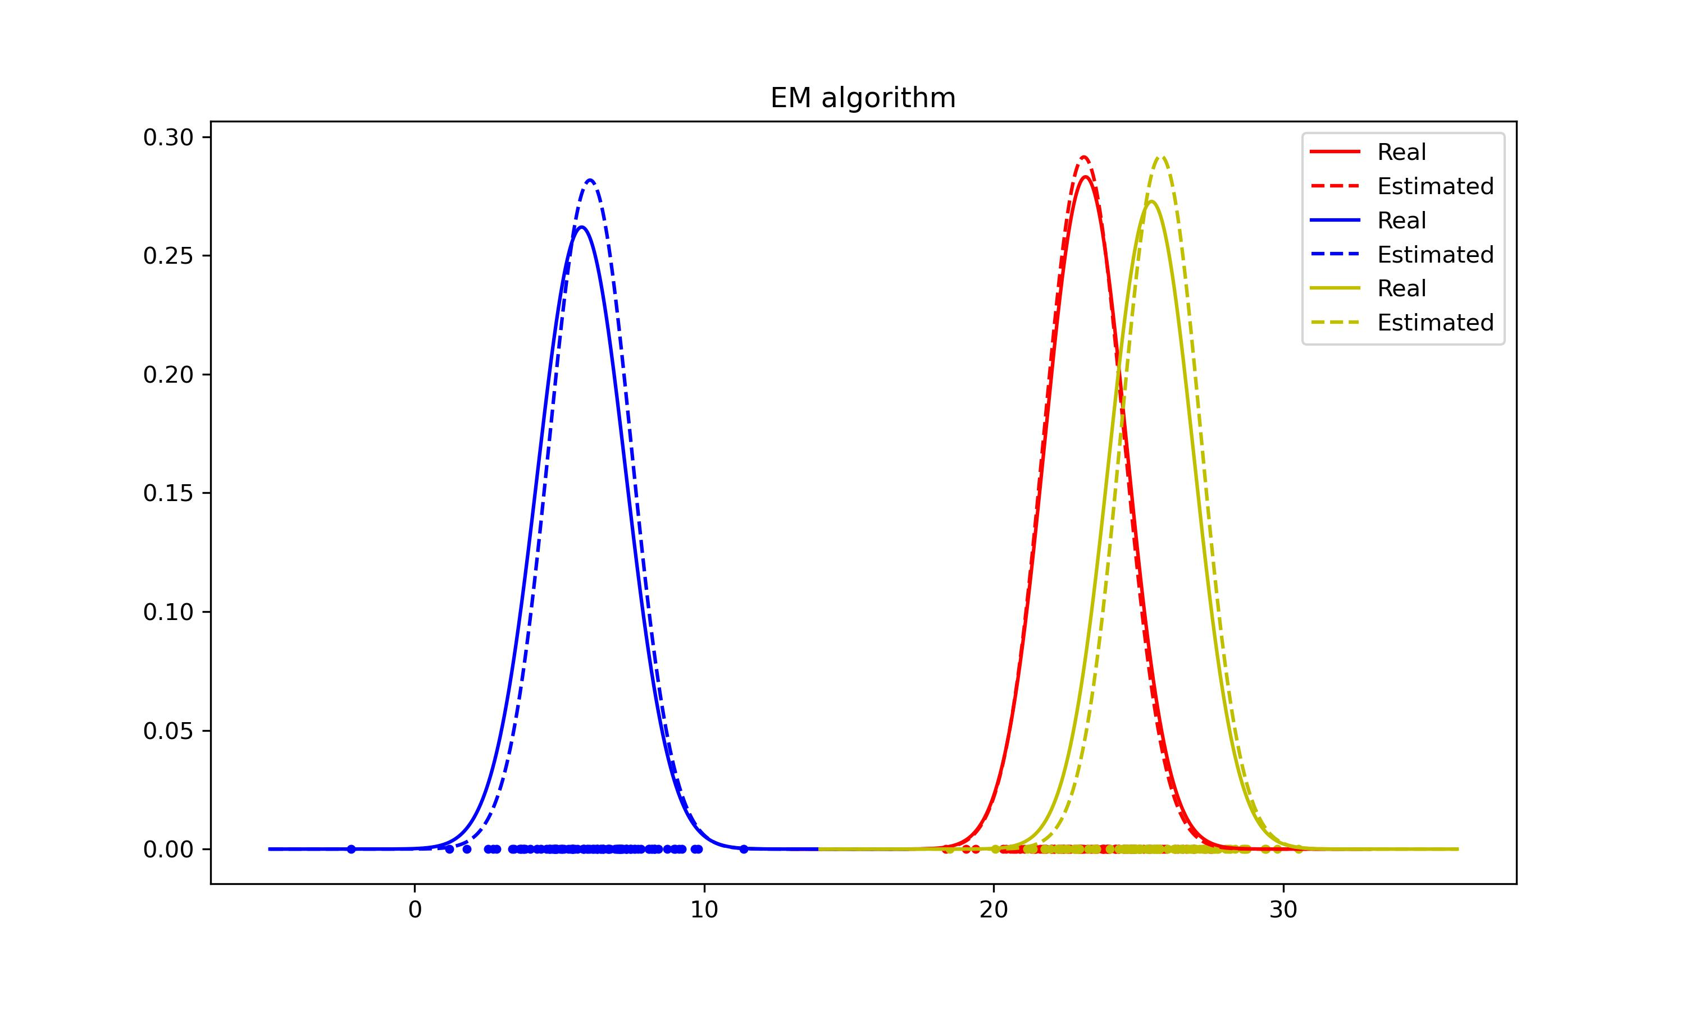
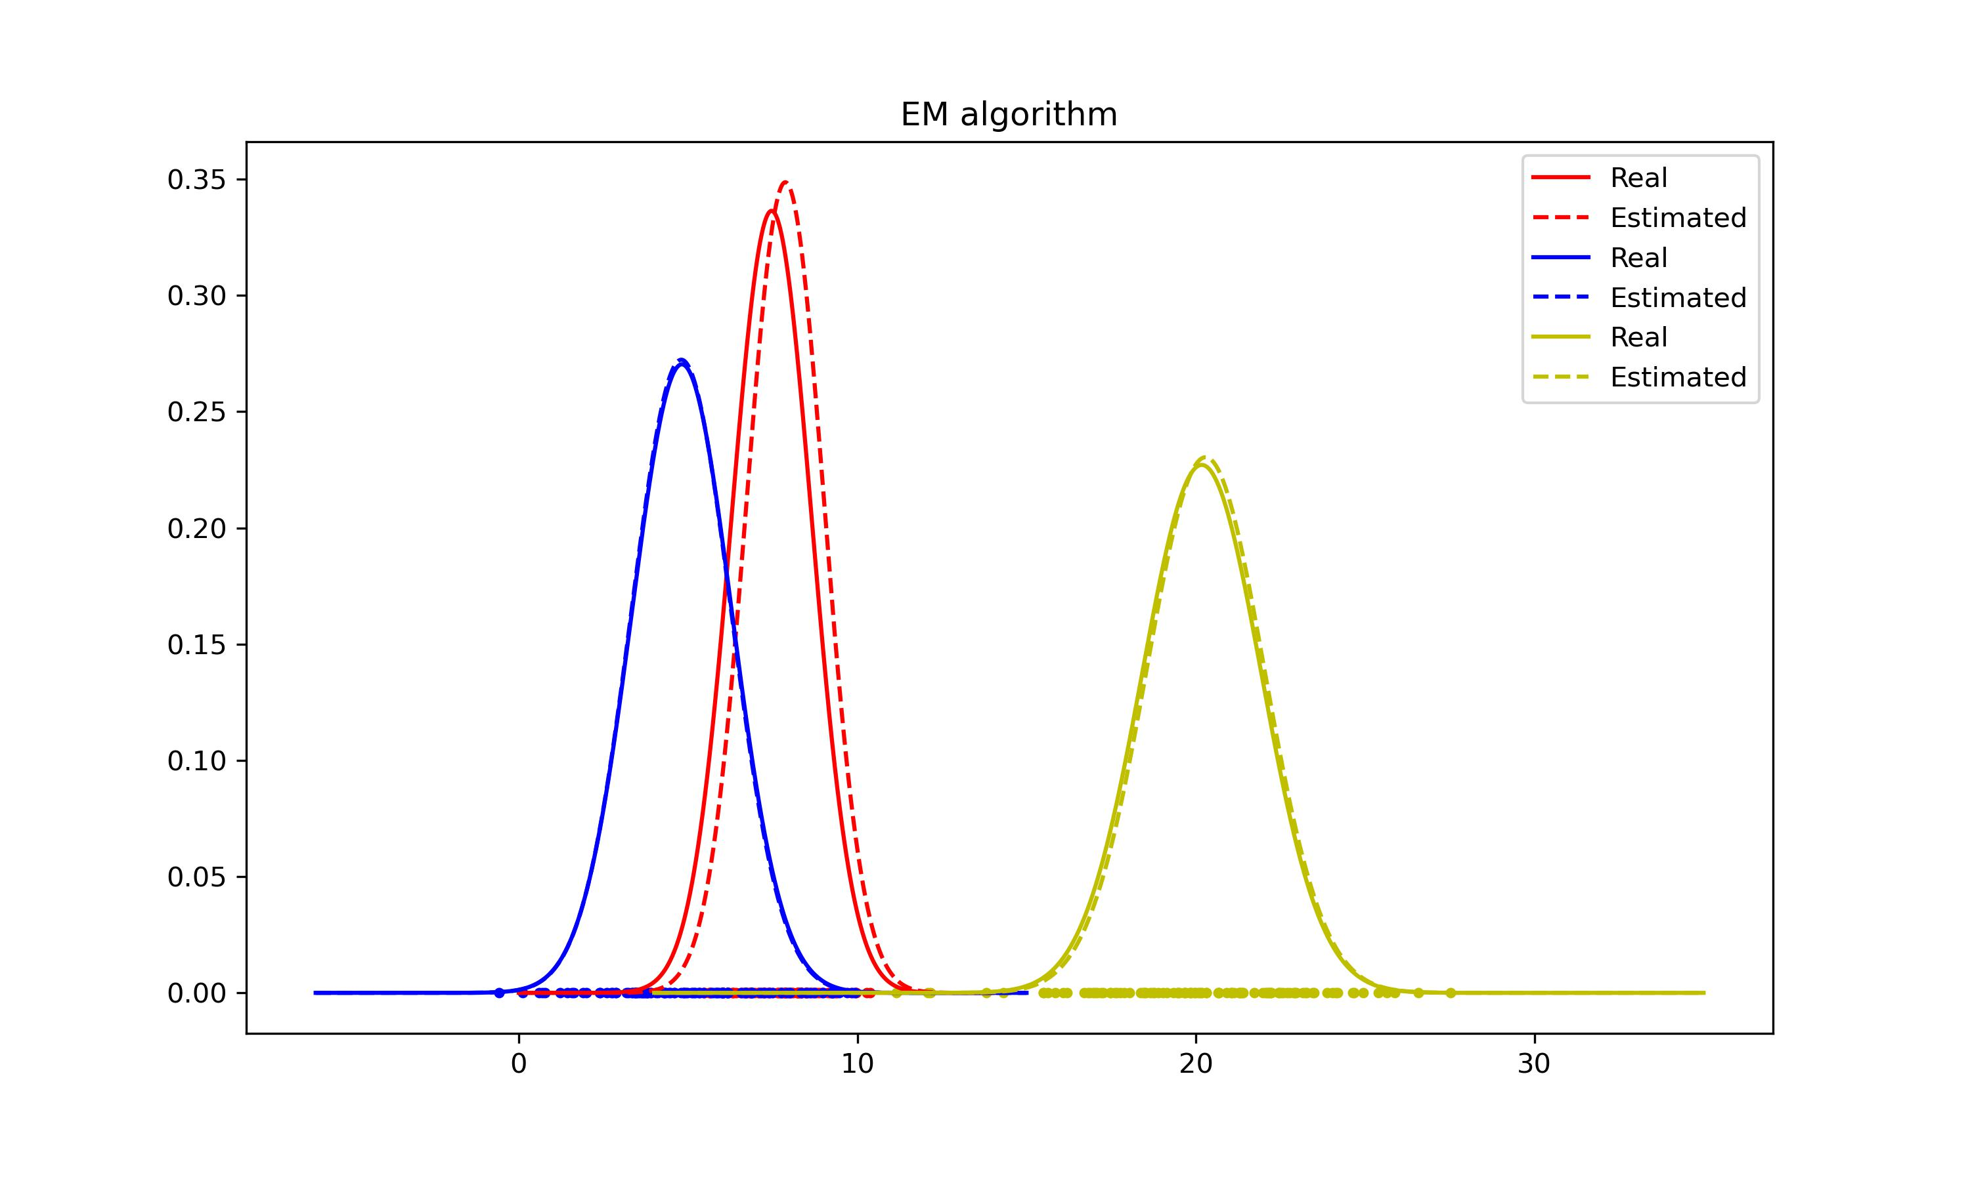
Work:
N groups
Here’s a bug!
Each group ~ normal distribution
N groups are mixed together
Divide this large
group into N groups
Estimate Mean and
Var for each group
Simple simulations of EM
(1-D Gaussian Mixture Model)
Notes:
Next part is easy simulation of Excepation maxization.
It’s a basic application of EM algo.
EM algo is complicated, I will spend more time on it later!

Slide 19
Work: Theoretical knowledge Learning
Signals and Systems
Application Materials
Course: EE120, Berkeley
This week's progress:
Lecture 4 (Fourier series in continuous time)
Lecture 5 (Fourier series in discrete time)
Lecture 6 (continuous-time Fourier transform)
Lecture 7 (continuous-time Fourier transform, continued)
Next week’s plan:
Lecture 8 (discrete-time Fourier transform)
Lecture 9 (discrete-time Fourier transform, continued)
Finish 2 labs
This week's progress:
Statement of Propose: 80 %
Research Proposal: 10 %
Next week’s plan: Submit
Notes:
The progress of Application Materials is not satisfying.

Slide 20
Questions
1. Bayesian related contents, how to write tutorials?
Notes:
Next are some problems I have encountered in my learning.

Slide 21
Thanks!

